Slide 1
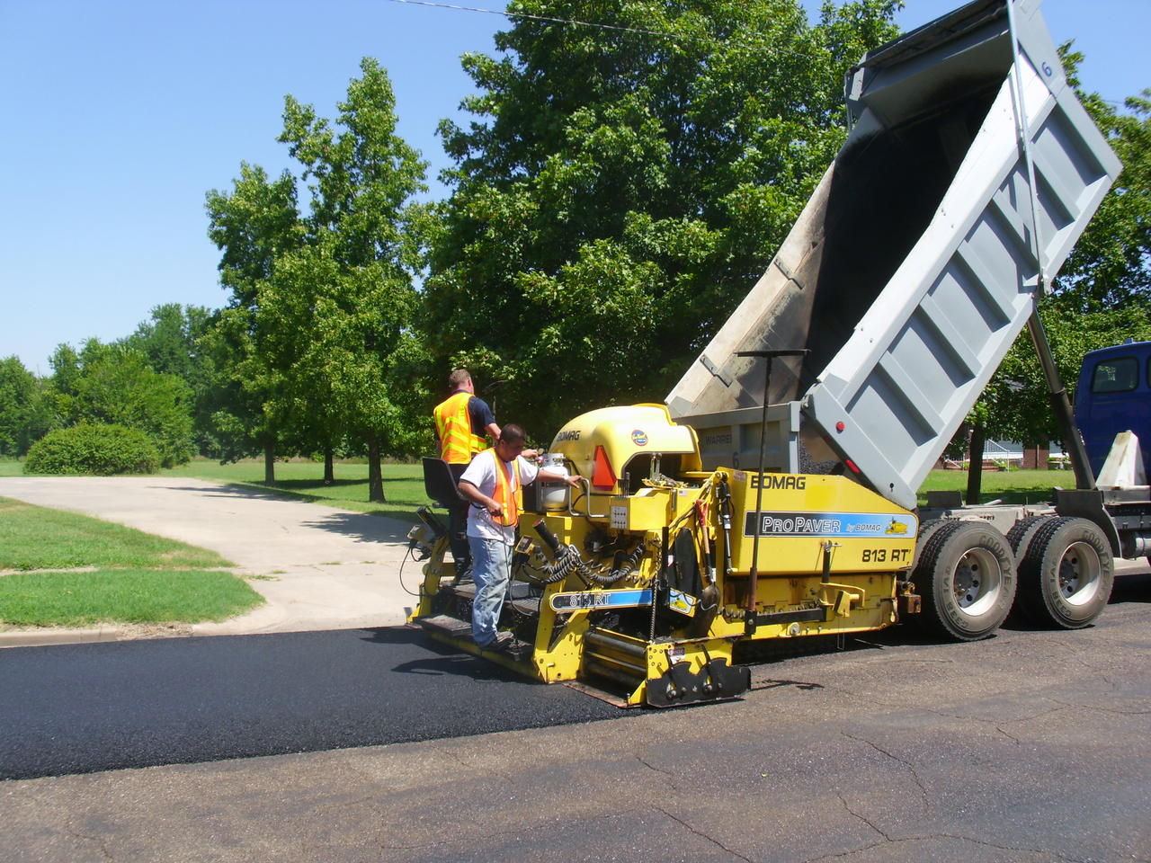
NPE Safety
Build & Run A Power Sweeping
Safety Program
Best Practices For Incident Prevention

Slide 2
Topics We Will Cover – MAKE NOTES!!!
Starting a Safety Program matched to the complexity of your work
Running your safety meetings
Safety topics to maintain employee interest
Performance recognition - critical Program element
Best ways recognize employee safety performance
Root Cause Analysis of incidents
Close Call reporting
The ways your safety program affects your insurance EMF
How to manage both to the best advantage.
“Best Safety Practices” to enhance an existing program
“Defensive Driving” practices – Defensive Fleet Management

Slide 3
Complexity Of Your Work = Complexity of Your Program
Outside sources of help are widely available and often free
Usually generic, not industry specific; customize
Start here: OSHA.GOV
cdc.gov/niosh
osha.gov/dts/sltc/
The more moving parts, the more procedures and controls
Learn what your industry looks like:
Trade associations
Publications
Conferences, seminars, etc.
SME’s, vendors, consultants, partnerships, etc.
Learn from Best Industry Practices.

Slide 4
Written Safety Manual & Plan
OSHA requirements: PPE, Haz Com/GHS, LOTO, Industrial Hygiene, BBP, First Aid, Fire Safety, Electrical, Underground, Falls, Confined Spaces, etc.
State Safety Plans – Unique Standards, Backing, Tree Work, Underground, Overhead
Company Specific – General rules of safety conduct
Site Specific Safety Plan – Customer Driven
Other – Insurance, reporting , etc.
Fleet – MVR’s, defensive driving, vehicle maintenance
Drug testing, cell phone policy, no texting, DRL’s; Conspicuity Markings, etc.
Hiring/HR & safety orientation; training & retraining; disciplinary/counseling
What do I do when…. “Someone won’t obey the rules??”
Employee mis-conduct; safety is not optional
This should be a Big Book! Documentation!

Slide 5
Safety Meetings (NOT Safety Training)
Select the best person to lead your meeting; this may not always be ‘The Boss’
The Boss needs to be in the room (in the audience)
Stay on message. Not a sermon. Not a gripe session
Engage the employees in the conversation. Ask for their thoughts
Daily & Weekly- short & to the point, focus on the days or weeks activity. More complex jobs with multiple tasks, daily
In some cases, a pre-TASK safety meeting or ‘huddle’ is good idea
Monthly – more formal, structured. Invite guest speakers. Videos. Show & Tell hardware
Tail Gate meetings are just that. Gather around, run thru the basics, confirm everyone is on board and understands, go to work!

Slide 6
Examples of Safety Meeting Topics
Internet – current events with a safety thread
Local daily newspaper – significant events and occurrences
OSHA.gov - Newsletter
You Tube – mind-numbing selection of videos. I.e. Russian Car Crash
Google Search: there are a LOT out there; bilingual, free
Subscription Services – Most are generic
State WC or Safety regulators; i.e. British Columbia
www2.worksafebc.com/Publications/Multimedia/Videos.asp?ReportID=34883
www2.worksafebc.com/Publications/Multimedia/SlideShows.asp?ReportID=33841
Free Safety e-Zine Subscriptions – EHS, FCP, Equipment Today, NPE
National Safety Council – Newsletters, Webinars, JOIN the NSC !!!

Slide 7
What to do when…..
Someone misses the meeting – have them read and sign the agenda; reiterate most important information
Cell phones: turn off before meeting. Bad news travels fast, you’ll get it
If someone misses 2 consecutive meetings, something is wrong. Figure out what and fix it
Invite your customers, clients, suppliers, others. They will usually find an excuse not to attend. You can fix this by giving out small gifts, donuts, etc. In other words, periodically incentivize attendance
Show Leadership through respect for the group, the content, the message
Take notes during the meeting; follow up on issues

Slide 8
Send It Home, Whenever you can
Paycheck stuffers with safety message
Parties, picnics, events for family
Gift certificates, household items
Toys, something for the kids
Family engagement is recognized as an extremely important motivator of employee on the job safety behavior.
Use this to your advantage. Repeat at Holidays
Holiday Safety Message, like in the ‘old days’
Warm Up Exercises: http://www.nbc12.com/story/30956787/construction-workers-exercise-on-the-job

Slide 9
Recognize your employees and their achievements: safety performance
Post your performance metrics: hours, jobs, tons, etc. Relevant statistics.
Look for ‘milestone’ events
Lunch or Breakfast Events – simple, themed, inclusive
Stuff – very inexpensive. Hard hat stickers, shoulder patches, etc.
Incentives & Bonus: ‘money is not a motivator’; use caution, do not discourage reporting
Jackets, tees, clothing, accessories
Gear, winter, seasonal
Outings, picnics, hot dog cookouts,
Holiday Messages – keep pushing safety

Slide 10
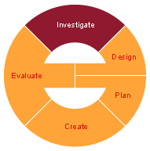
Root Cause Analysis
More than just ‘he’s at fault’
Look upstream as far as needed
How to do an investigation, how not to
Ask ‘Why’ FIVE TIMES!!
Everything that happens AFTER the incident does not belong on an investigation report.
Ask for help when needed. File preliminary report, amend/ update
Reminder: we drug test for everything.
Check the WC laws in your state, or ask your insurance company, what happens to a claim if there is a positive test? i.e. reduced or denied benefits

Slide 11
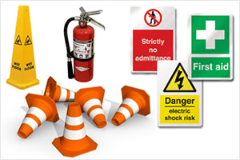
Safety Training
Classroom based, or combination of field & job site
Hands On, show & tell, supervised demonstrations, etc.
Verbal & written
Videos
Use OSHA guidelines – equipment, tools, PPE, practically any topic will have a ‘training’ component.
Ex VOSH: Unique Standards: www.doli.virginia.gov/vosh_enforcement/vaunique_standards
More complex tasks – more detailed training.
Use Vendors, SME’s, sales reps, State Safety people, cooperative programs, etc.

Slide 12
Why You Need to Enforce the Safety Laws
Because OSHA could find YOU negligent
They will often reduce your penalty after an inspection if they see you have an active Program with fair discipline measures
You will stay out of the OSHA Severe Violator Program
Clients requirements: show proof of your safety efforts at time of bid
Because the other party’s attorney can use ‘failure to enforce’ as evidence against you, say for negligence
Because your insurance company will keep renewing your policy
Because some WC programs will deny or reduce benefits for employee misconduct.

Slide 13
Close Call, Near Miss – Gotta’ Have It
Anonymous reporting – sterilize the feedback
Reward for reporting – simple thank you, PPE, etc.
Investigate your Close Call reports to the extent needed
Keep track, data crunch the numbers to see where the minefields are
Teach & Train based on your findings
Use on-line apps, i.e. ‘I-Audit’
Unacceptable: NO REPORTS. This means no one is looking closely enough.

Slide 14
Insurance – when & how to file a WC claim
NEVER file a claim (Avoid filing small claims; manage them in-house)
Make sure it needs to be filed. Serious losses, ex.
Set up an account with your local clinic
Drug test for everything
Direct pay for as much as possible
“Please do not over-treat my employee”
Light Duty Program; Early Return To Work
Job Descriptions required for Doc’s

Slide 15
Best Safety Practices Adopt or Write Your Own
General Motors just threw out the rule book! For example….
Adopt Best Management Practices for as much of your operation as possible
Best Safety & QA/QC Practices
Paving, striping, sweeping, driving, etc.
Specify a metric, a standard, a guideline, for as many discrete activities as possible
Measure everything; report everything; provide feedback

Slide 16
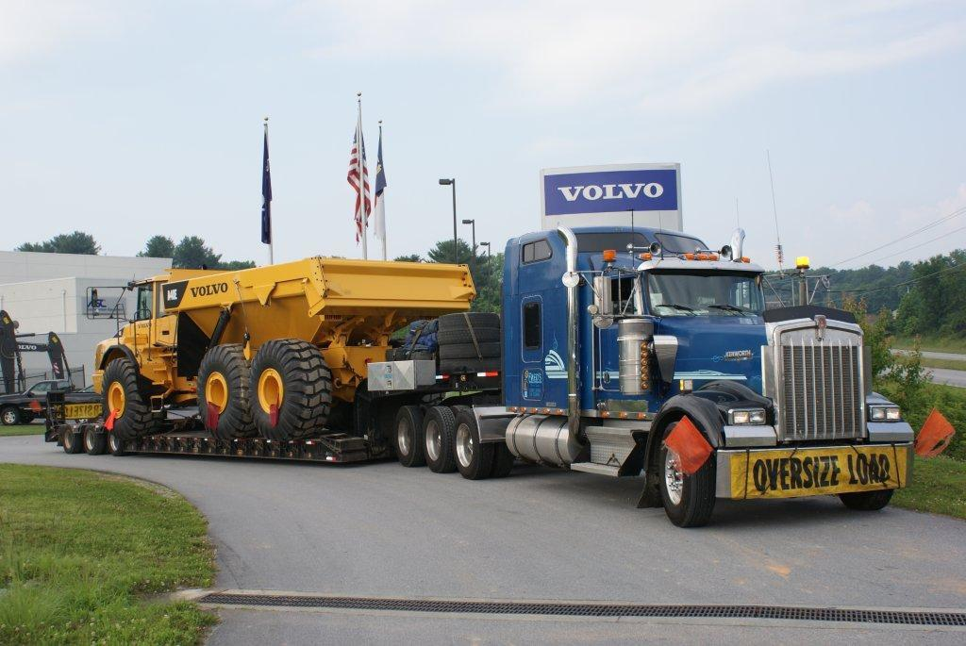
Defensive Driving Tips for Construction Fleets
Day Time Running Lights – all units-LIGHTS
Inspect & clean the rig before rolling out
Secure the rig, stuff on the back
Test the brakes; trailer hitch, safety chains, lights, conspicuity markings, etc.
Avoid overloading; cover/tarp all loads
Make sure the bed is DOWN
Pick safest route – avoid congestion
Early AM, late afternoon, early evening, avoid rush hour; NIGHT!!
Use toll roads, interstates. Avoid 2 lane undivided

Slide 17
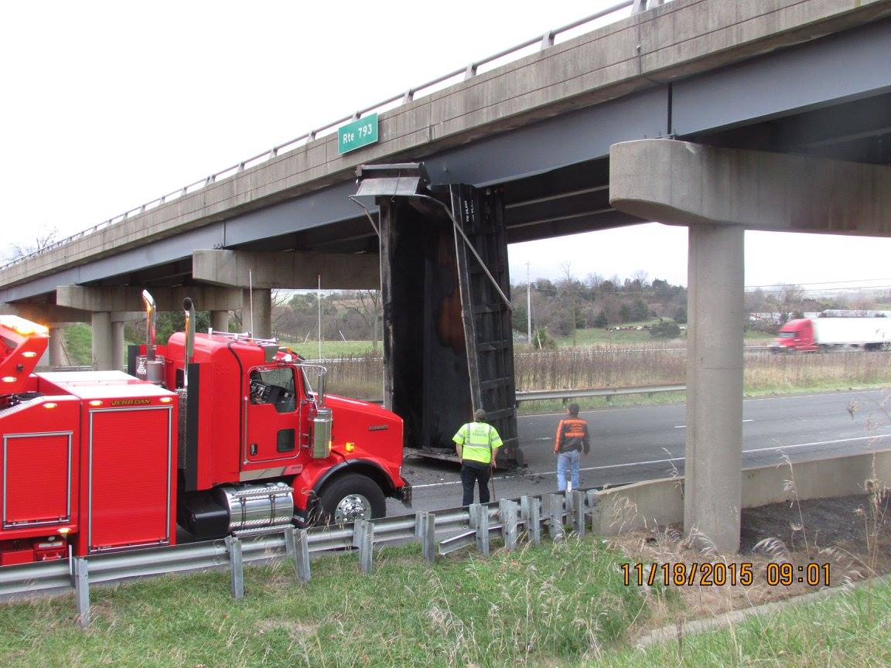
Defensive driving - continued
Train & Inform your drivers; CDL/DOT Safety Meetings
Leave space – LOTS of space ahead of you
Fatigue issues – manage drivers time
Overnight shifts, snow, etc.
LOTO for operator/mechanics/drivers
Over-height warnings in cab
Protect your rear
Blind side backing & use of Spotters
Tip: Pressure Washer!!

Slide 18
For Extra Credit
Pre-shift safety meeting followed by POST Shift de-briefing!
Warm up exercises before shift
Use of I-Audit to track and record
JHA’s / AHA’s are increasingly common. Become familiar with writing one
Learn the language of your customer – manufacturing, retail, commercial, etc.
Include Industrial Hygiene into your program – i.e. heat stress information, silica dust exposures; noise – free app.
Hydraulics – park on mats or surface where leaks can be found; use bibs and diapers on hoses. Repairs made off-site. Commercial spill kits, mats, pillows, etc.
Water Gel Burn Blankets

Slide 19
Important element: Safety committee
Select the right mix of Members
Functional levels, administrative, recognize, empower
Cross-section of employees
Examples of things the Committee can look at:
Trial safety gear- ‘stuff’, tools, gear
Job safety performance issues
Seasonal or shift issues
Safety suggestions
Improvements
Near misses
Bring in guest speakers, SME’s

Slide 20
Site Specific Safety Plan (SSP)
Customer and job specific; written plan for your client’s site
Incorporate the major elements of your Safety Program
Include JHA’s, AHA’s
List the major steps of this job; safety precautions specific to each stage of job
Include: Responsible persons; contact info.; Competent Person; safety trained operators, reportings & investigations, etc. Who does what, etc.
Specify: Site access, postings, security; housekeeping; daily meetings; post shift debriefings, pass down logs; night work & lighting; theft prevention, repairs & maintenance, etc.

Slide 21
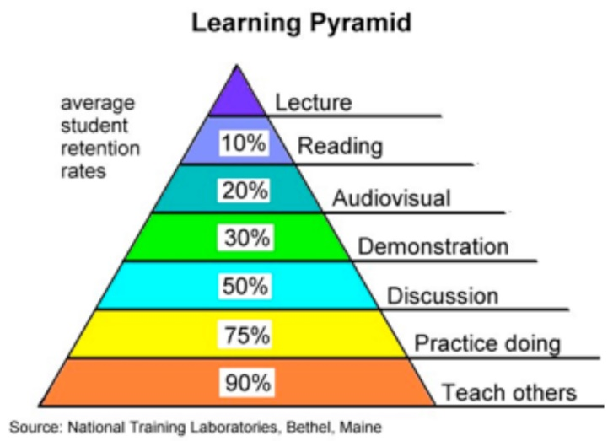
Operator ‘Safety Training’
Does not mean ‘how to run the machine’
Does mean: Safety features and safety practices associated with the machine
You Tube; manufacturer web site; vendor & sales reps; manuals; use CAT example
Classroom & field based; show & tell; demo.
Issue a credential (wallet card)
ANY piece of equipment will qualify: paver; roller; chain saw; chop saw; Bob Cat; back hoe, etc.
Review decals, warnings, danger/caution, gauges, lights, safety practices, i.e. wheel chocks, steering wheel covers, LOTO, etc.
Typically every three years or when new machine is added. Includes attachments.

Slide 22
The Long view…..
How long do you plan to be in this business?
Adopt a Continuous Improvement strategy
Structure a ‘Next step’ development plan for each employee
Investment in equipment, processes, complexity, technology, etc.
Membership/ Officer ascendency in peer organizations
Participate in industry recognition events
Achieve Leadership recognition in the industry

Slide 23
Summary & Review – Q&A
We covered a lot of information in 90 minutes
Everyone is by now a ‘Safety Expert ‘
Programs must be dynamic, evolve & grow with your organization
Keep the Program up-beat, positive, dynamic
Show recognition, compassion, understanding, respect
One person in the organization will not carry the entire Program, must be shared among all – management, supervision, employees
Leadership – Culture – Commitment!!

Slide 24
Speakers Bio
Certified Safety Professional (CSP); Associate in Risk Management (ARM)
Secretary & Past President, Colonial VA Chapter, American Society of Safety Engineers
Adjunct Instructor, VA Commonwealth University, Risk Management Institute
Author: Construction Safety Guide; Fork Lift Safety Guide
OSHA 500 Construction Outreach Trainer
OSHA Haz Mat Technician; Disaster Response & Recovery
BA in Education, RI College
Safety Director, Pillar, Inc. Richmond, VA
www.pillarens.com
jmeola@pillarens.com

