Slide 1

April Safety Info
Emphasizing Work Zone Safety Week
Spring Creates Upswing in Incidents — Focus!
Time to Prepare for Busy Season
Stay Defensive in All You Do
Hand & Finger Injury Prevention

Slide 2

Work zone safety week
The Week That lasts all year!
Drive Like You Work Here!
See the Cone
Respect the Zone
Education & Awareness are the best preventions.
Drive Defensively & Leave Room Ahead

Slide 3

Spring fever don’t catch it !!
Annual bell curve of incidents starts trending upwards
FOCUS!! Avoid distractions.
Random multi-tasking = asking for error, fail, incident
99.99% preventable ; authorities will ask hard questions
Longer daylight hours – we try to do more
Fatigue; hydration; diet; exercise
Get on board with your ‘New Years Resolution’

Slide 4
Prepare ahead & report near miss incidents
Close Calls & Near Misses – every day, something is happening around us. Report these to management so we can discuss and train!
PPE – Now is the time start to looking at warm weather gear – make selections for upcoming nuclear summer.
Tools, Hardware… Check your gear and equipment for needs in upcoming busiest season.

Slide 5
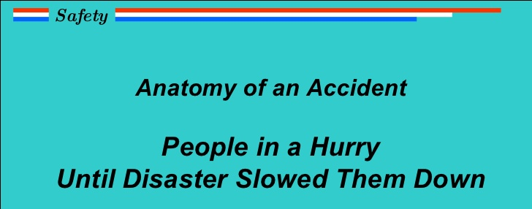
Defensive Driving
Backing – parking – positioning
5 keys of defense
Emphasize AWARENESS and defensive positioning in and around traffic
Pedestrians – Watch out because many of them are now distracted as well with phones, kids, etc.
There has been a statistical surge in losses — including highway workers.
LOOK with central vision – do not rely on peripheral vision to detect oncoming vehicles.
PROTECT with distance; allow time for reaction – look and plan well ahead

Slide 6

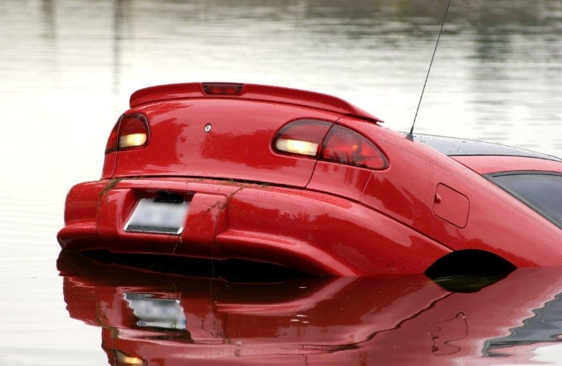
The Weather... NOT just small talk OR a ‘nuisance’
Spring rains = possible monsoons
Think of hydro-planing possibilities on highways
Take high water and flash flood warnings to heart!
Watch out for sinkholes and other geological failures
Other climactic aberrations – nothing would be surprising at this point…
Prepare and beware (“be aware”)

Slide 7

Hand & finger injury prevention
Best Practice- ALWAYS USE A TOOL; glove; rag; other interface
Avoid direct skin contact – unless it’s a computer keyboard
Look where you place hand — finger — body
Look for sharp edges and things that might pinch, snag, crush, tear, impale, etc.
Mechanisms of injury – improper tool use; poor posture, strains, pressure points; slippage from a poor grip
Decal, sign, mark, warn, protect, advise
Glove selection; different types best for different applications
No jewelry; no unbound long hair; no loose ends; THINK, accidents happen QUICKLY!
Slip & fall – boot laces and eyelets – an untied shoestring is enough to bring you down

