Slide 1

December Safety Info
Covid Precautions
Holiday Safety Reminders
Defensive Driving in Cold Temps.
PPE & Job Site Conditions
Report Close Calls

Slide 2
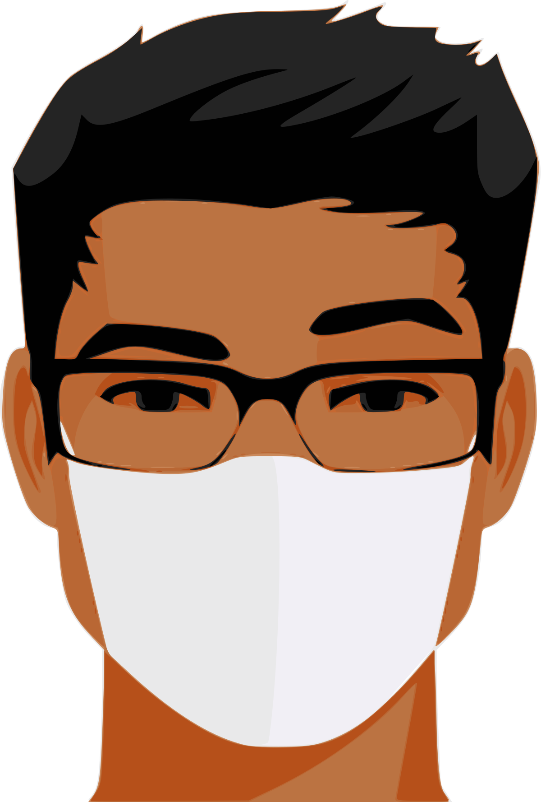
covid Preventive Measures
All persons wear a face covering when applicable.
Protect your breathing zone. This is why the air dryers are deactivated in lavatories.
Avoid crowds, maintain distance around unknown persons, avoid questionable gatherings.
Recognize risk factors; reduce exposures when possible.
Hand sanitary practices — wash or sanitize often; avoid touching face or eyes
At home: regularly change the air filter on your heating appliance. Use high-grade filter media.
Stay properly hydrated. Get seasonal flu shot. Cover mouth and nose if you cough or sneeze.
If you feel ill, do not come into work. Report the situation and quarantine until tested.

Slide 3

Holiday Safety Reminders
Decorating the house & yard – use proper ladder and climbing practices. Avoid improvised access. Have a helper assist.
Electrical – avoid outlet & plug overload. Check wiring for defects or pinch points. Common source of home fire. Use GFCI outlet on outdoor electrical installations.
Check HVAC system; wood stove or fireplace safety; proper ash disposal
Check function on smoke and CO2 alarm. Avoid parking vehicles indoors.
Check fire extinguisher; plan a safe escape route for upper floor occupants
Stress is a common issue around Holidays. Understanding & empathy can help. Patience. Neutralize.
Covid reminders for gatherings. Consider virtual alternates. Travel precautions apply. Use appropriate controls for in-person events.
Avoid night driving when possible. Impaired drivers more common after dark.

Slide 4
Defensive Driving in COLD Temps.
When we see the ‘little white lines’ on the pavement, expect some type of precip. Most DOTs pre-treat in advance of inclemency.
SLOW DOWN when road is wet, iced, snow. BRIDGE DECKS will ice over.
Posted speed = dry road, daylight, passenger vehicle. Otherwise, make adjustment.
Carry extra WEIGHT in vehicle for improved road-holding traction
Avoid bulky garments while driving. Interior will warm up quickly. No hoodies.
Hands-free, no distractions. Deer season precautions. Clean headlights.
Grip fabric, light weight GLOVES can help with a cold steering wheel.
Clean glass & mirrors to reduce glare; use scraper on frosted glass. Keep spare washer fluid handy, supplies may run down if the weather turns.
Wear a high-vis. garment when walking on or near travel lanes, parking lots, etc.

Slide 5
PPE & Job Sites
Typically a large Client will specify PPE for their site.
Otherwise, we need to adopt Best Safety Practices based on location & exposure.
Standard complement of PPE includes: head, hand, eye, foot protection; appropriate clothing including high vis outer garment.
Multiple types of PPE are available in each category depending on task.
Good practice: carry two types of gloves, tinted & clear lens eye protection; muck boots & work boots, etc.
KNOWING WHEN TO SWITCH THEM OUT is key.
One type of PPE may not be adequate for all tasks encountered.
If you need specialty PPE, contact the company’s Safety Manager.
Using PPE is a key safety behavior. Using the right type of PPE earns extra credit!

Slide 6

‘Close Call’ Reporting
Close Call reports are indicators of perceptual safety awareness.
Failure to recognize or ignoring a Close Call is a form of risky behavior. As a rule, we are a risk-averse organization.
Recognizing and reporting a Close Call is an indicator of well-developed cognitive ability.
“Boots on The Ground” or behind the wheel, Close Calls are a form of reality check. They are ‘almost’ events that want to send a warning message, large or small.
Failure to report a Close Call is a bit of denial we do not particularly need in our Safety Skills inventory.
Please step up & relay the ‘learnings’. Your report can make a difference & help prevent a repeat situation, which could result in a different outcome.
Anyone can report a Close Call via text, e-mail, phone, picture, video, etc.
All we need to know is: WHAT ALMOST HAPPENED

