Slide 1

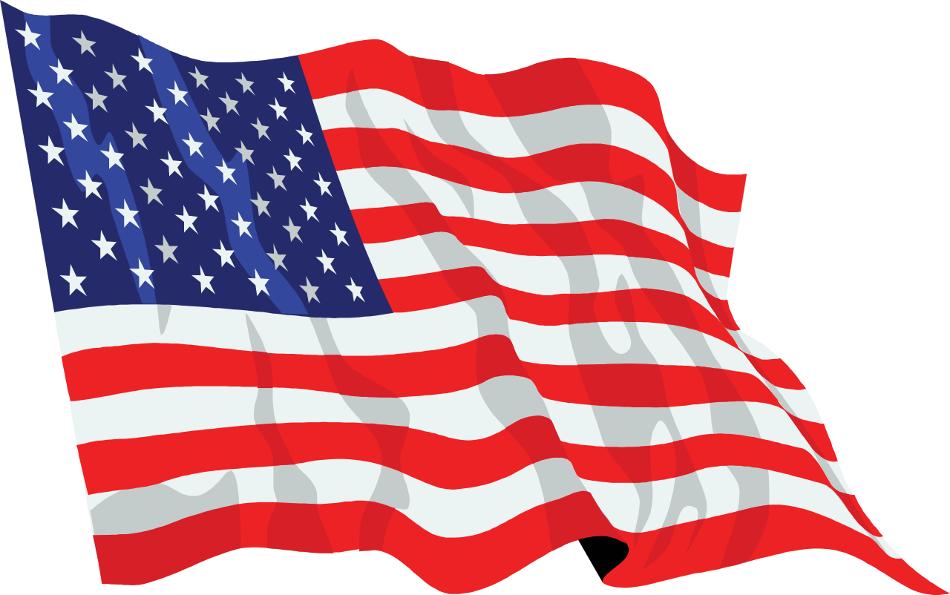
July Safety Info
Covid 19 & Inter-Social Distances
In Hot Weather Stay Hydrated!
Hot Weather Defensive Driving
Poison Ivy and Other Poisonous Plants Avoidance
Be Sure to Report Your Close Calls

Slide 2

Covid Did Not Take the Summer Off
Our lessons in Industrial Hygiene continue…
Awareness of surroundings & space; clearance of 6-10 feet to avoid spew droplets.
Air flow & entrainment; face covering near others; avoid congested areas
Hand, face, skin sanitary practices; eye protection is recommended
Shared & touch surfaces; use glove or other interface
Sanitize personal use items, belt & buckle, footwear, keys, phone, earbuds, glasses, etc.
Hand WASHING; avoid cross-contamination; supervise kids to the best extent possible
Sunlight is a helpful disinfectant; rainy days not so much.
Watch where you step and walk in parking lots.

Slide 3
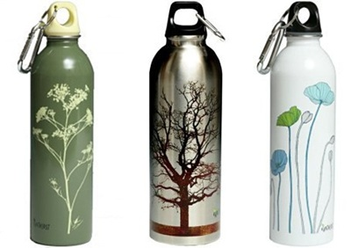
Heat: Hot and Hotter = July & August
Buy more watermelon, peaches, strawberries
Drink more water, Gator-ade, squincher, lemonade, etc.
Think electrolyte replacement!
Eat Less heavy meals; more salad, less fat, skip the fries, have a tomato, fruit, corn, hydrating veggies
Water cooler & ice bucket challenge – drinking liquid that is too cold is not good
Cool to room temp is best for assimilation – otherwise our body has to work harder to absorb H2O
High heat can accelerate fatigue. Get adequate rest cycle; REM sleep

Slide 4
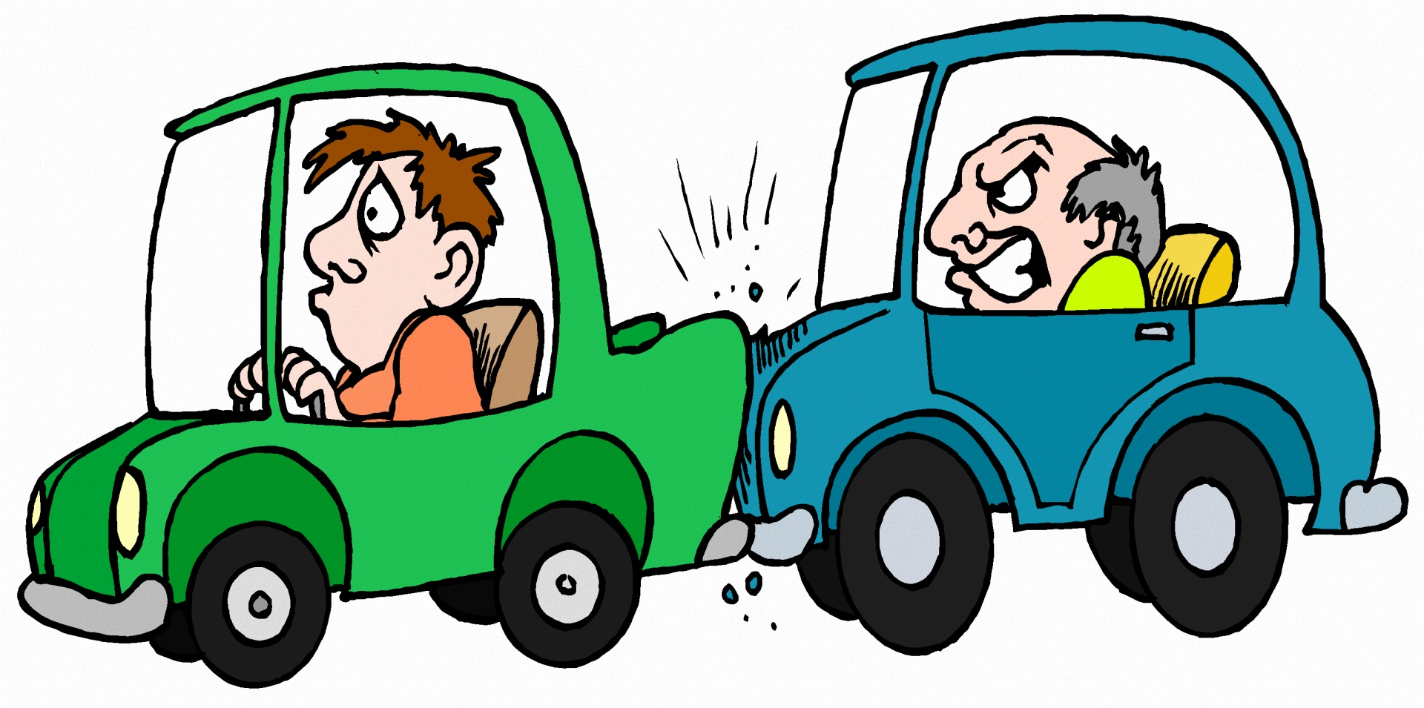
Hot Weather Defensive Driving
High Heat is tough on vehicles. Tires, battery, electrical systems, hot steel and glass, etc.
High temp on road surface - may affect tires. Check pressure and tread-wear patter
Avoid road rage situations; use defensive positioning
Make sure they see you! Wear your vest; stay visible; stay in defensive, protected positions
Semitrailers – if you hear a slapping noise from tires, back off. The tread is separating and indicates a failure is likely. Stay well away – the tire carcass can cause a wreck.

Slide 5
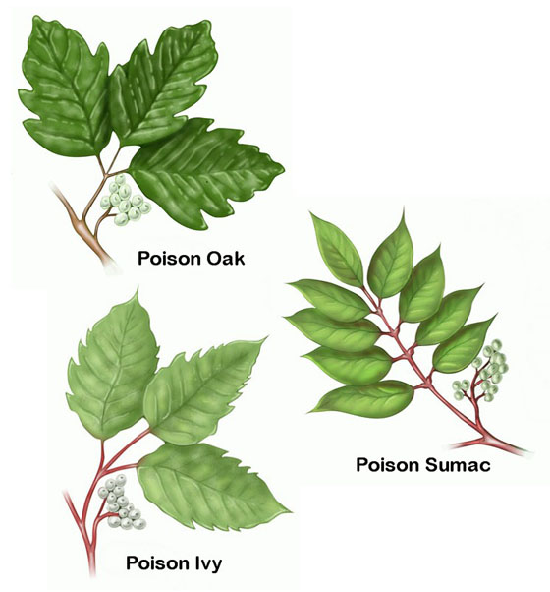
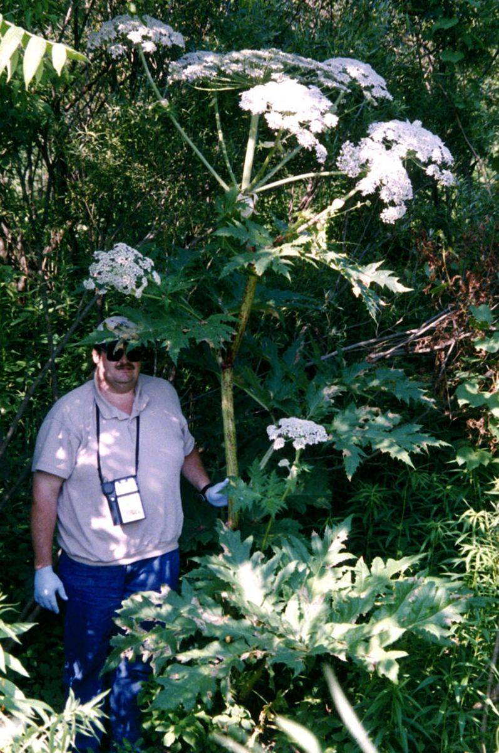
Most Common Poison Plants
Treat all vegetation as suspect.
Wind turbulence can cause spread of contaminant across branches and limbs.
Avoid contact as much as possible
Practice Social Distance when available
High sensitivity persons: PPE- Hard hat & face shield, gloves, long sleeves; barrier crème; etc.
Avoidance is best practice. Once the irritant oil is on you, it is not easily removed.
Avoid touching eyes, face, mouth, etc.
Giant Hogweed

Slide 6
Close Calls and Reporting
Close Call reporting is important to our Company. This is how we avoid ‘landmines’.
If you have a close call while sweeping or with any of the other services we provide, be sure to report it to your supervisor. We will then share the report for improved safety awareness.
Every time you step out of your vehicle, things can change — or sometimes while you’re still in it!
• Traffic, job site, people, weather, other trades, client operations, etc.
Make a Safety Assessment during each of your projects; before you act, think it through.
Factors: walking & climbing surfaces; vegetation & insects; weather; PPE; tools & gear; vehicle driving, backing, parking, loading & unloading, etc.
Wear high-viz apparel routinely. You’ll never know when it will save your life.

