Slide 1

March Safety Info
Cold and Flu season – Including Covid-19
Footwear and Back Health-related Factors
Springtime Defensive Driving Tips
Ergonomics 101
Spring Fever and March Madness… …Will be occurring even without the sporting events!

Slide 2

Cold and Flu season – Including Covid-19
Awareness for contact surfaces – hands primarily- Wear a GLOVE whentouching shared contact surfaces Like fuel pump handles, door handles, shopping cart handles, ATM keypads, etc. Use a glove or tissue to avoid skin contact.
Gas pumps, door knobs and handles, public spaces, hand railings on stairs, etc. Avoid direct skin contact whenever possible.
Keep sanitizer handy, use often, WASH HANDS with soap & water often (follow 20-second rule recommendation of CDC)
Avoid touching your face and NO handshaking. Keep your distance from people.
Footwear can track a lot of different contaminants. Be aware of this, i.e., when using rest areas or public restrooms. Sometimes there is a puddle… Good hygiene is not routinely practiced by all.
Cover your mouth/nose if you cough or sneeze. Protect your eyes. They are mucous membrane magnets for airborne droplets as well as if you touch them with your hands, shared towels, etc.
Stay well hydrated to enable bodies defensive systems to properly function.

Slide 3
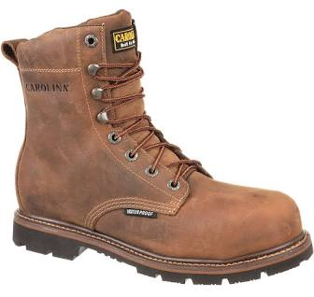
Footwear and Back Health-related Factors
A good pair of work boots will move to more than just protect your feet. Where a pair of boots designed for your work environment. Defeat support legs, hips, dorsal – spinal column and deserve proper attention.
Foot care involves more than footwear but it’s a good start. Condition of boots is important since worn soles and tread means the boot does a lot of the work when it’s in proper condition.
Avoid loose cuffs. Tuck them in or otherwise strapped them securely. Loose cuffs are also a vector for ticks and other insects.
Prolonged standing or walking on pavement or other hard surfaces can affect your feet negatively. Cushion souls or inserts are important to relieve the impact of “heel strike” on pavement.
Avoid wearing wet or damp boots. If your job description calls for getting wet feet, keep a spare pair handy for change out. Dry your feet completely after showering, Since this helps foot and toe health. Change socks if needed to keep your feet dry. Allow your boots to dry thoroughly overnight; stuff with newspaper to work out moisture. Remove the insoles and wash or replaced periodically.
Slip and fall prevention starts with a stable platform for the foot. Risk factors include: upper body weight transfer on uneven, irregular surfaces, runs, toeholds, changes in elevation, distractions, carrying objects, walking while yakking on the phone, etc.

Slide 4
Springtime Defensive Driving Tips
Watch for pedestrians. Nationally, the statistic for pedestrian/vehicle accidents is increasing. Remember, these days many pedestrians are also looking down at their phones.
Look for persons on foot who are crossing roadways outside of the crosswalk while wearing non-distinct color of clothing, etc.
Leave sufficient following distance in all driving situations; always practice the four second rule of following distance.
Slow down at intersections; slow down well before taking a turn; never try to beat a light.
Use of seatbelts is mandatory on all vehicles, including ATVs. An insurance claim may be questioned for failure to use safety equipment properly.
Stay alert and think! Do not take a risk for comfort or convenience.
Whenever you are out of your vehicle make sure you are visible, ideally by wearing at least a high viz. vest. Remember that glare may make you invisible even with high viz. apparel!

Slide 5
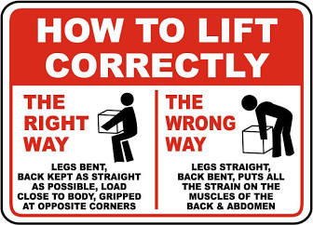
Ergonomics 101
Before you start to lift, be sure you stretch and flex your body. This is medically proven to reduce soft tissue injury, strain, sprains, and etc.
Use the correct posture for high force and repetitive tasks — like lifting, for example!
Try to keep the load you are lifting close to you. Avoid a long stretch out in front of your body. Reposition the load or your posture as needed.
Remember: your strength zone is between your knees and chest. Outside of this range, use extra caution.
Use a correct stance and foot positioning, whether walking, standing or climbing.
Avoid prolonged awkward postures; if you will need to be in an awkward position, stretch and flex before hand in order to limber up.
When swinging a tool above your shoulder height, remember that your shoulder is weak when your arm is extended.
When doing a repetitive motion such as hammer strikes be sure to use a benign posture, as well as grip and stance.

Slide 6

Spring Fever and March Madness Will be occurring even without the sporting events…
The fact is, people often behave unpredictably in early spring.
For your personal safety practice heightened awareness both on and off the job.
Springtime risk factors include: sleep deprivation, chronic fatigue, dehydration, impairments, distractions, etc.
Examples: people running red lights; glare blindness while driving; longer daylight hours equal longer work shifts and less sleep.
A combination of the above factors and more may create unpredictable hazards in any environment.
Practicing personal safety awareness in all situations – on and off the job – is the best defense for March Madness.

