Slide 1

December Safety Info
Covid Precautions
Holiday Safety Reminders
Defensive Driving in Cold Temps.
PPE & Job Site Conditions
Report Close Calls

Slide 2
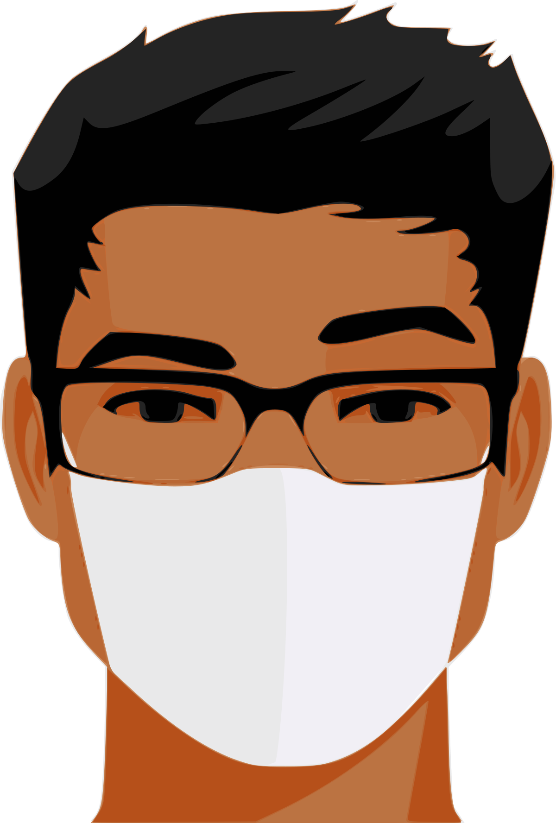
covid Preventive Measures
All persons wear face covering when applicable.
Protect breathing zone. This is why the air dryers are deactivated in lavatories.
Avoid crowds, maintain distance around unknown persons, avoid questionable gatherings.
Recognize risk factors; reduce exposures when possible.
Hand sanitary practices- wash or sanitize often; avoid touching face or eyes
At home: regularly change the air filter on heating appliance. Use high grade filter media.
Stay properly hydrated. Get seasonal flu shot. Cover mouth and nose if cough or sneeze.
If you feel ill, do not come into work. Report the situation and quarantine until tested.

Slide 3

Seasonal Safety Advisory
Glare Hazard – morning & afternoon; use tinted lenses /sun visor to minimize effect when driving.
‘No Hoodies’ when driving. Avoid bulky outer-garments when driving
Wear high-viz garment when ‘boots on the ground’
Remember: other drivers facing the sun MAY NOT SEE YOU.
Park, stand, walk in a protected location when exposed to traffic.
Minimize your exposure to moving vehicles in all situations, including parking lots, low-speed / congested areas, etc.
Deer Season- install deer whistles on your vehicle. Deer are most active at dawn or dusk in rural and suburban areas. Moderate speed.
Daylight saving time- lose 1 hour of daylight; earlier darkness.

Slide 4
OSHA Revised Walking & Climbing Surfaces Rule
FOCUS on safe navigation of whatever terrain you are walking/working on.
LOOK where you walk/step. Any change in surface elevation can cause imbalance.
Take smaller steps on irregular or unpaved surfaces; caution on steep slopes; ascend/descend on a tangent to minimize grade; use a walking stick or other aid when appropriate.
Position instrument or tools in best configuration for carrying to avoid imbalance. Use shoulder straps or backpack. Keep hands free when possible.
Wear gloves – when you fall, they help disperse impact.
Footwear should be suited to terrain & conditions; tuck in cuffs.
‘Slip & Fall’ incidents are entirely preventable.

Slide 5
Defensive Driving – Best Practices
‘4 Second’ interval following Distance – stay well back from vehicle ahead
INTERSECTIONS of all types = high collision frequency. NO DISTRACTIONS!
Pedestrians; bicyclists; WORKERS ON FOOT (i.e., Survey personnel, joggers, etc.
Most sweepers are part of a fairly rugged fleet versatile, well maintained; rear-wheel drive vehicles in snow/ice depend on TIRE TRACTION. Moderate speed.
Variable temps. can cause road/bridge icing overnight. Be alert for this possibility.
Wet leaves=slippery. Winds can be highly variable; tree hazards
PPE = eye, face, gloves, head protection; high viz apparel should be universal.
Regularly clean headlight & tail lamp lenses.

Slide 6
Everything Else….
Holidays can be individually stressful. Be considerate of others.
Seasonal and time change may increase fatigue, disrupt sleep patterns. Normally not a big deal but in some cases, decisionmaking ability may be impaired. For a driver, this could be problematic.
Stay properly hydrated during colder weather. Part of the body’s viral defense mechanism depends on mucous membranes (eyes, mouth, throat, nose)
Respiration of cold, dry air in flu season can be minimized with face covering.
Throat lozenges, gaiters/masks, eye and face protection can help minimize irritation from cold air. Nicotine is a vaso-constrictor.
Seasonal family protection=flu shots.

