Slide 1

October Safety Info
Driving reminders for upcoming deer season
Right-of-way in crosswalks + parking safety reminders
Avoiding distractions while driving
Prepare for and dress for seasonal cold weather beginning
Defensive driving tips in cold weather
Your PPE: Check and maintain it!

Slide 2

Deer Season Opens SooN
Especially dangerous for parking area sweeping with early AM commute in known animal habitats.
Deer Whistles are recommended– ‘poor mans’ insurance policy – passive or electronic
Moderate your vehicle speed; dew point; rain; other compromising conditions
Posted speeds include multiple risk factors: do not routinely ‘push it’.
Braking; pavement design, roadway geometry; your tires, lines of sight, etc.
If encounter deer: immediate HARD BRAKE; anti-locks will kick in.
Extreme caution on two-lane, undivided roads. Avoid a sudden ‘swerve’. This can lead to loss of control; lane departure; roadway departure; bad outcome.
Most deer hits are not fatal. Average animal weight: 300-400+ lbs. Your truck: 6000+ lbs.
We have insurance. We have air-bags. We have EMS.
Truck has frame-bonded triple laminate safety glass windshield.
In other words, do not make sudden ‘swerve’ to try and miss the deer.

Slide 3

Crosswalks & Parking Reminders
In many states drivers must make complete stop for pedestrians and bikes who are anywhere in a crosswalk. They — not you — have the ‘Right of Way.’
Often applies on any road with speed limit less than 35 mph.
LOOK well ahead at intersections. Check clearance on sides and rear of your vehicle. Avoid sudden lane changes.
Extra Caution – School Zones, bus stops, other marked or unmarked transit points, i.e. commercial & retail areas.
Parking lots- extreme caution: slow speed, stay well away from other parked vehicles. Big Box stores usually have ample free space AWAY from entrances.
Avoid ‘front of store’ area. Park defensively in a clear area. Use ‘drive-thru’ parking spaces to avoid backing.
Bonus points: place a traffic cone in front of your vehicle when parked. This indicates a ‘work vehicle’; most other drivers will avoid crowding you.

Slide 4

Avoid distractions When Driving
Avoid DISTRACTIONS of all types. In the vehicle & surroundings.
Driver: FOCUS on safe driving: NO ‘infotainment’ – NO Texting.
Wingman: If you have them let them do the navigation & gabbing.
Complex visual background factors: electronic signage & advertising gimmickry; mendicants in median; street furniture; graffiti; lighting; debris, foliage; line of sight impairments, shadows, your tinted lenses; dirty glass or mirrors, GLARE; signalized intersections, etc.
NEVER try to ‘beat the light.’ Highly perilous.
It doesn’t take much to create a distraction. In the cab or external.
FOCUS on safe driving in all environments, particularly in congested areas.
If you need to take a call, pull over to a safe area or send to v-mail.
Do not risk creating a distraction for any reason.

Slide 5
Annual Seasonal Cold Weather Metabolic Change- Starts Now
The body will begin a period of adjusting to colder temps. This takes place over several weeks.
Help this process by maintaining proper hydration; quit or cut down smoking; avoid junk food; maintain proper rest cycle; take the thermals out of storage.
Highly recommended: pre-work stretching exercises
Dress in several light layers. As the day warms, adjust for comfort.
Safety Tip: Your OUTER garment should ALWAYS be High Viz
Certain geographical areas are more subject to frost, rime, black ice, etc.
Weather patterns have become increasingly bizarre and unpredictable
Coveralls offer best general comfort & heat retention.

Slide 6
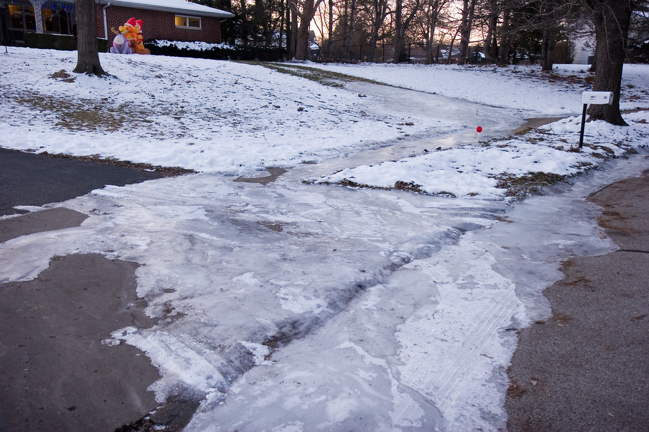
Defensive Driving in Cold Weather
NO HOODIES while driving!
Check vehicle tire pressures at least a couple times during fall season. Dashboard TP indicators are generally reliable. Adjust pressures as needed.
TP affects handling, braking, steering, footprint in rain, sleet, etc. An under-inflated tire can LOSE up to 25% contact surface. Why take this risk?
Check pressures on ALL VEHICLES in your household.
Keep glass & mirrors clean — interior & exterior.
Clean the back-up camera lens. Install deer whistles.
Early AM driving- check your local air temp. Bridges and other infrastructure may ice up with no warning. VDOT is relatively prompt on pre-treating pavement but they are not omniscient.

Slide 7

Check Your PPE – ‘Inspect’ & Maintain
All forms of PPE must be ‘ANSI’ approved.
Most PPE articles will be marked with an ANSI number.
Primary eye protection is included. Check your ‘Ray-Ban’s.
Gloves & hand protection and other PPE may be Project or Client specific.
Foot protection: ANSI rated footwear is generally the standard.
Muck boots should have protective toes.
Keep your safety vest clean – launder as needed. Replace before the color fades. Sunlight exposure will gradually degrade reflectivity.
If you hike, jog, walk your dog, take kids in stroller, etc. WEAR HIGH VISIBILITY GARMENT. It’s not just for ‘work’; stay visible to drivers in all environments.
Use a tool holder when heavy hammering; keeps hands and fingers away from strike zone. A 4 lb. sledge can rearrange a lot of soft tissue.

