Slide 1

February Safety Info
Winter Weather Safety Precautions
5 Keys of Defensive Driving
Hand & Finger Injury Prevention
Reminder to do Close Call & Near Miss Reporting
General Advisory Ideas re: Towing & Loading

Slide 2
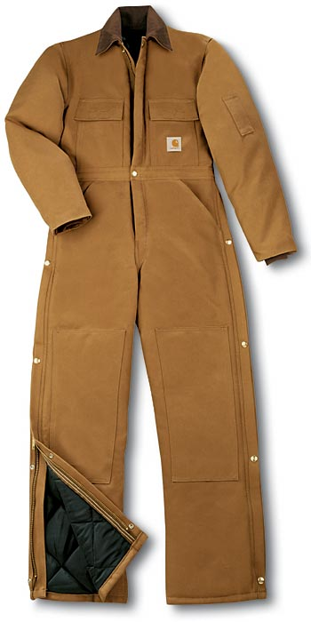
Winter Weather Safety
Days are lengthening; @ 2 minutes per day
Sunlight Glare hazard will persist early to mid-morning
Early morning road icing hazard; bridge decks can freeze overnight
Dress in multiple light layers: i.e., thermals, bibs or coveralls;
No hoodies while driving or under hard hat
Maintain hydration; use hand /skin crème; face covering helps minimize respiratory tract dryness from cold air;
Headwear selection can make a big difference; most heat loss is from neck and head.
Helmet liner & hard hat = good protective assembly in cold & wind
Glove selection depends on protective factor such as ANSI Cut Level, impact resistance; surface & grip material; tool use, dexterity, etc.
High visibility outer garment is recommended for practically all ‘Boots-on-the-ground’ exposures, in all environments

Slide 3
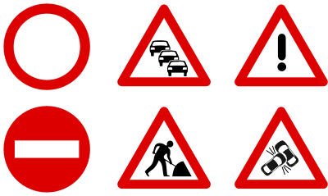
5 Keys of Defensive Driving
‘Aim high’ in steering – look well ahead; ‘15 seconds’
Get the Big Picture – front, back & sides
Keep your eyes moving
Make sure other drivers ‘see’ you – avoid blind spots
Always leave yourself an ‘Out’. Avoid being compressed in traffic; stay well clear of trucks.
Maintain @ 4 second following distance at all speeds.
Practice good ‘lane discipline.’ Not doing so is one of the leading causes of Road Rage; emphasize proper use of signals.
Intersections of all types — including parking lots — have the highest crash frequency
# 1 cause of crash = following too closely; #2 = backing into something.
Early AM start-out: let vehicle warm up, run defroster while you clean glass & mirrors.
If snow/ice accumulates on roof or hood, try to remove as much as possible pre-trip

Slide 4
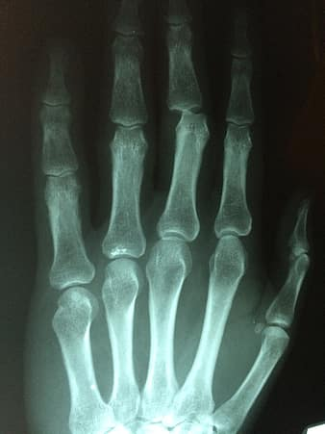
ElimiNate Hand & Finger ‘Owies’
This is a common daily exposure in field operations.
Risks include: Pinch points, sharp edges, irregular shapes, awkward hand and finger positioning, bare skin contact, hidden hazards, moving parts, etc.
Assess your activity for hand hazards: impalement, puncture, laceration, crush, impact, hot/cold, hand and arm FORCE; hammer or tool use; etc.
Glove type & protective factor should be matched to the exposure.
Use C Clamp, vise-grip, etc. to hold while hammering, NOT fingers.
Remember that cold temps will affect dexterity.
You may need more than ONE TYPE of glove on some exterior projects

Slide 5
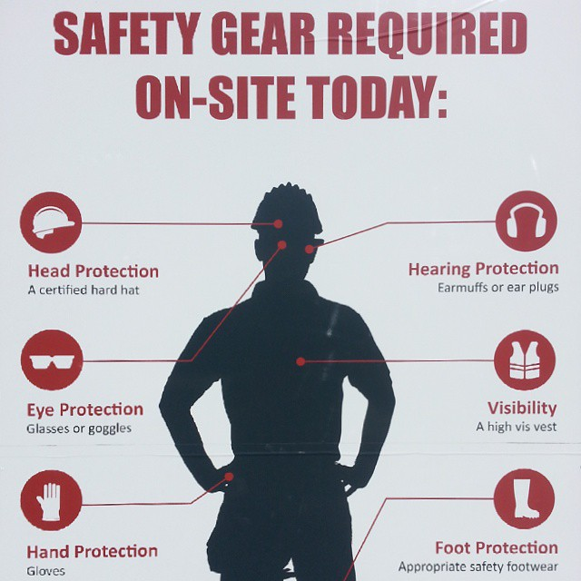

REMEMBER: DO Close Call & Near Miss Reporting
These reports add to our awareness and understanding of RISK factors. What you learn by ‘others’ oops’ could help someone in our organization avoid the same issue. Typical categories include:
Driving, especially backing
slip & fall
materials handling
tool use
interactions with other contractors
tree and vegetation issues
Environmental, including weather
PPE ideas or current insufficiencies
Ladders
Anything else out of the ordinary that occurs

Slide 6
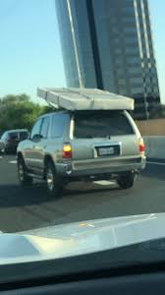
Towing & Loading of Vehicles
Trailer hitch inspection & maintenance applies to the vehicle AND the trailer. Safety chains should be hitched in an ‘X’ pattern; inspect for brake and directional light activation.
Cargo tie-down straps – make sure you have a sufficiently rugged grade of belting. Wind load on oblique surfaces, such a boat, can be appreciable.
Use at least THREE separate straps for improved security. Check the strap tightness when traveling long distances, on freeways, etc. Use chafing gear on sharp edges. If a proper tie-down or cleat is present, use it.
Caution when using ‘compression’ holding force from the straps alone and remember that roof-mounted or towed objects will receive high wind force.
Lost load, displaced objects are common occurrences. Look for signs of fastener failure, i.e., rust rings, abrasion, missing fasteners.
Vibration, stress, overloading, wind loads, etc. can create issues.
Moderate your travel speed when towing or transporting roof-mounted objects.

