Slide 1


January Safety Info
Covid Reminders — CDC Advisory Info
Nuclear Winter — Again
Defensive Driving Reminders
PPE on Jobsites/Stake Pounding BMPs
Safety ‘Deliverables’

Slide 2
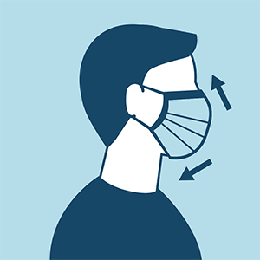
Covid Precautions VOSH ETS / CDC Advisory
Social Distancing – Face Covering – Hand Washing – Indoor Air Quality
Awareness for ‘indoor air current entrainment’. Wear your mask if sitting under any air vent.
Avoid congregating indoors & out. Covid exposure is primarily a respiratory transmission. Protect your breathing zone. Droplets travel. 6 ft.+ distance
Hydration – important year ‘round. Mucous membranes = 1st line of defense
Self-quarantine after a questionable exposure.
Get tested if you start having symptoms of illness or there is a confirmed case among your recent contacts.
Indicators include: Fever – Cough – Muscle ache – Diarrhea - Nausea

Slide 3

Nuclear Winter Again…
Farmers Almanac predicts “a light winter for most of the US.
Warmer-than-normal temperatures forecast for large part of the country.”
This usually results in highly variable temperatures freeze overnight, mid 40’s+ daytime.
Can create dangerous early AM road & bridge icing. Use extreme caution on commute.
Ice/snow precipitation: will thaw during day. Standing water = hydroplane hazard, plus ice over if wind-chill reaches freeze point.
Dress in light layers to adjust for swing in temps. Outer garment should be high-viz.
Extreme cold — consider coveralls or bibs, boot, helmet & glove liner
Wear face covering/ gaitor to minimize breathing cold (dry) air, which can be irritating. Stay hydrated. Wear eye/face protection.
Recently a client advised NO HOODIES under a hard hat. Interferes with correct fit and suspension. This makes sense. Use a proper helmet liner instead.

Slide 4
Defensive Driving Reminders
NO DISTRACTIONS. FOCUS on the road. Hands-free phone. Limit calls.
Moderate your speed. Posted limit = 4 wheeler passenger vehicle, daytime, dry road. All others: ADJUST SPEED FOR CONDITIONS
Most common accident: following too close. Allow 4-second interval.
Intersections of all types = high crash frequency. Scan well ahead and all around your vehicle. SLOW before entering intersection.
Do not ‘crowd’ the stop line. WAIT when signal turns green. Running a red light is common fail. Allow an interval for safe transit.
Daytime Running Lights = ‘hi-viz vest’ on your vehicle. ‘Make Sure They SEE YOU’ is one of the 5 keys of Defensive Driving.
Deer season; Glare; road icing; poor drainage; standing water; Road Rage (Holiday & Covid stress); defective equipment; bad brakes/tires; long list of ‘fails’ contribute to crash hazard.
Protect yourself at all times; in and out of the vehicle.

Slide 5
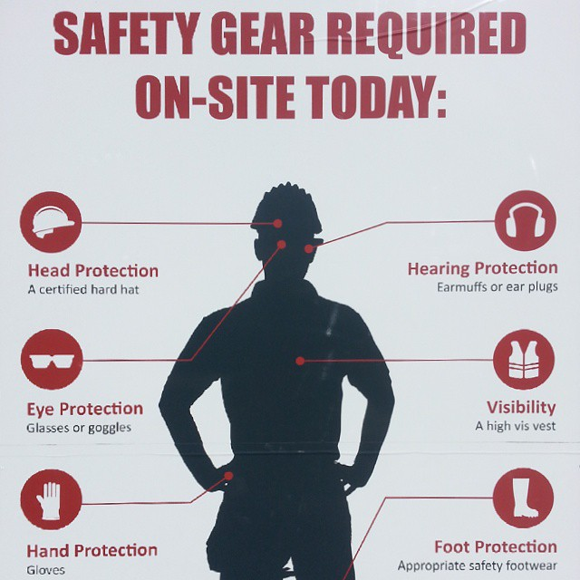
PPE On jobsites and When pounding stakes
Safety glasses may fog up depending on temps. Use anti-fog spray; carry spare pair of glasses; clean tissue to wipe.
New types of a hard hat have a tight fitting, built-in face shield. No need for safety glasses with a visor in place. Careful: Fogging may also be an issue in cold.
Hand protection – ANSI Level 8 is becoming new normal; with cut and impact protection
One suggestion: pre-drill a stake pilot hole in difficult surface conditions. This lessens the impact force required from a hammer.
ALWAYS use a tool holder: keep hands free from strike zone. Use a ‘stake holder’ tool, Vise Grip; needle nose plier, etc.
Avoid awkward posture – such as bending to ground level. This creates ‘mis-strike’ hazard.
Knee pads: permit improved postural alignment & balance; less chance of mis-strike
Learn from Best Practices; adopt these defensive measures as a best practice.

Slide 6

“Safety Deliverables”
Prospective clients sometimes ask about our ‘SAFETY RECORD’.
We are proud of our historically good safety performance and achievement.
However, it does not take much to push our statistics to a ‘questionable’ level.
Most all incidents are PREVENTABLE… and letting us know about close calls is a way to help teach everyone else the possible pitfalls we have on our jobsites.
We are essentially ‘self-directed’ on a client site. YOU are OUR representative in safety & technical ability. In that order.
We are highly qualified in power sweeping. We also need to be equally proficient in all-things SAFETY. If you have questions or need assistance, SPEAK UP.

