Slide 1
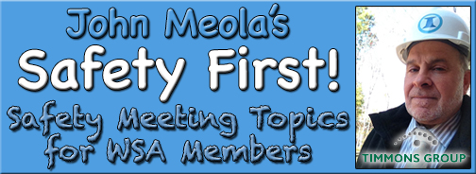
July Safety Info
Heat Index & Hydration
Wild Kingdom: Insect, reptile, critter, avian, etc.
Defensive Driving – Summer Version - Road Rage
Hurricane Season & Tree Hazard

Slide 2
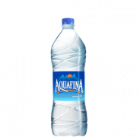
New OSHA Mantra: ‘Water – Rest – Shade’
Stay properly hydrated. Water, lemonade, certain other supplements
Avoid the Red Bull, Monster, etc. Sugar & Water Junk. NO soda!
In high heat & humidity, be mindful of your general body functions: solid & liquid intake, sleep interval, and other metabolics.
Don’t try & push it. Each person handles HEAT differently. Take a break in shaded area if needed.
Dress code can impact the body heat load. Torso, neck, head should be ‘ventilated’ as much as possible to allow evaporative cooling.
A tight fitting Tee Shirt is basically wrapping the heat into the body interior.
If you need to wear high viz, consider a mesh vest or alternate.
Certain applications: cooling bandana; cooling vest; nape protector on hard hat; hard hat sun visor, etc.
Engineered garment & fabric improvements offer SPF, insect & UV protection

Slide 3
‘Wild Kingdom’ & ANY Field Operations “There are over 800,000 species of insects…” Wiki
“They got here first”… we are basically invading the turf of whatever is on the property.
Identify the most likely inhabitants on the Take 2; plan from there
Reliable pests include: BEES-hornets-wasps; mosquitoes; ticks, poison plants, reptiles, spiders, birds, rodents, etc.
PPE can help in some cases, but there may be a tradeoff with high heat index. Do the calculus & make a conservative decision.
Link to NIOSH tips for hornet & wasp avoidance: https://www.cdc.gov/niosh/topics/insects/beeswasphornets.html
This advisory includes some interesting observations from their etymologists
Use repellant as directed; reapply as needed; CO2 attracts the bugs. No perfume or cologne, etc. Carry hornet / wasp spray; ice pack if stung
Multiple stings: may need an ER visit. Allergic reaction: call 911
Report all incidents to your supervisor, Project Manager upon occurrence

Slide 4
Defensive Driving – Nuclear Summer
Road Rage incidents SPIKE – back off, use courtesy; yield ROW to others, aggressive drivers. Poor lane discipline causes a lot of rage incidents
Tires will heat up: our TG truck fleet can usually handle this easily (TY to M. Spede!) but check your family van/SUV/etc. TP & tread-wear are main elements
JUNK on the roadway: tractor trailer tires tend to EXPLODE more in high heat. Stay well away from large vehicles.
Next month: mattresses & furniture will line the roads when school reopens
Daytime Running Lights (DRL’s): these help identify your vehicle in all lighting conditions.
In high GLARE conditions, remember that you may be INVISIBLE to other drivers.
Be mindful of SUNGLASSES: avoid over-use of tinted lens. The human eye is light seeking. This is why DRL’s are effective.

Slide 5
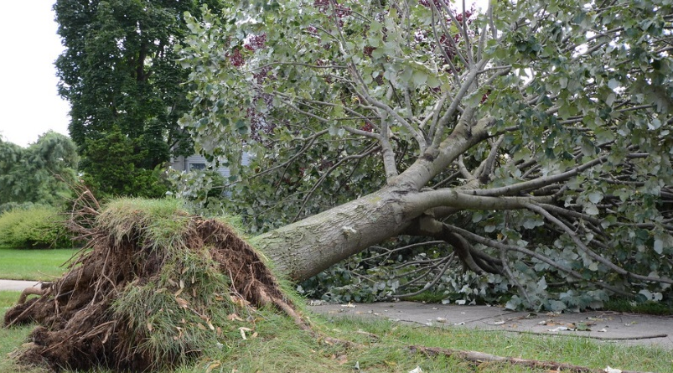
Hurricane Season & Tree Hazards
LOOK at the trees closely for signs of distress- use binoculars if needed
Hazards include: distorted canopy, tilted trunk, root ball displacement, hung up limbs, split trunks, lightning damage, displaced critters & nests, vine entanglement, etc. etc.
Link to US Forest Service- Hazard Tree Evaluation Guide:
https://suddenvalley.com/wp-content/uploads/Hazard%20Tree%20Evaluation%20Tatum%20Guide%202015.pdf
Take NO chances: wind gusts may dislodge leaners or hung up wood. Stay in protected area or avoid entirely.
Post-storm — wind & rain — obviously is when trees are more susceptible.

