Slide 1
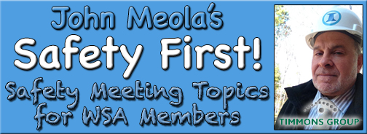
June Safety Info
Hydration – Nuclear Summer
Walk – Stand – Climb – Slip & Fall Prevention
Ergonomics- Positioning – Weight Balance
Hand & Finger Safety
Eye – Face – Head Protection
Defensive Driving – Summer Temps FLARE

Slide 2
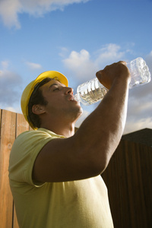
Hydration Nation
Water – Rest Break – Shade = Outdoor worker mantra from OSHA & CDC
June temps will likely be on ‘London Broil’ setting
Stay well Hydrated – this means more than chugging a couple bottles of water
Don’t Push It! If you are being hammered in the sun, get into shade & ease up.
Rest breaks = more frequent in high heat
Shade in some form- umbrella – vehicle- sun brim hat- shelter - canopy, etc.
Drinking water must always be readily available
Diet – carb loading in high heat should be managed. Lunch should be minimal during high heat. Avoid grease, fast food, etc.

Slide 3
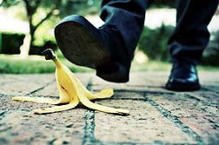
Walk –Stand- Climb – Slip & Fall Avoidance
Watch where you are walking! Tripping over ‘own 2 feet’ is common hazard
Footwear selection should match the terrain. High tops are recommended
Those little eyelet cleats on work boots are basically snag hazards
Laces, cuffs, hem lines, etc. can snag on these eyelets. And they don’t ‘give’.
Step over or around stuff on the ground. This is how ankle strain occurs.
Use a walking stick when appropriate. This provides improved upper body stability. 60% body weight is above the waist, so we are basically top heavy. Uneven ground adds to disequilibrium – loss of balance.

Slide 4
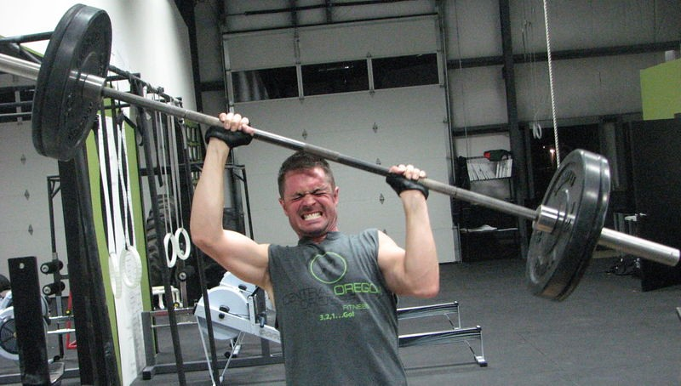
Ergonomics for ‘Field Ops’
Walk-stand-climb dynamic is basic physics to ‘get you there & back.’
Prolonged bending crouching kneeling can cause muscle ‘stasis,’ meaning you cannot move so easily to ‘get up’ from a cramped position.
This can cause sudden high force load on a soft tissue mass that has been deprived of circulatory capacity from the crouch. When you’re ‘stiff’ do ‘Stretch n’ Flex.’
GET UP SLOWLY. Transfer body weight proportionally to avoid strain on a body part.
Use a ‘crutch’ to assist getting up — this could be anything to help stabilize and shift your weight. I.e,. tool, tripod, stake, co-worker, etc.
It doesn’t take much to ease the strain when re-positioning. Your ankle, foot, leg and back muscles will appreciate the assist.

Slide 5

Hand, Arm & Finger Injury Avoidance
Includes wrist, elbow, shoulder – upper extremity function. This involves a leverage equation and mechanical risk evaluation.
LOOK before sticking your hand into a: toolbox, compartment, culvert, pinch point, hinge, etc. Think: What can crush, impact, stab, bite your finger?
I.e., opening a manhole lid, reaching for a tool or handful of rods, using high hand or finger force, hammering, pulling on a jagged object, MACHETE USE, clearing brush, digging, etc.
Use proper PPE/gloves for the work. Use correct hand ‘posture’ – pinch rip, hook grip, power grip for the task.
Avoid placing all of body weight onto single point, i.e., elbow or knee, on hard surfaces.
Caution: anytime the arm is raised above the shoulder, there is a high force exerted on the rotator cuff. This is a relatively fragile part when out of position. A torn cuff is painful, does not heal easily, surgery is not 100% fix. You won’t be picking up your kids for a long time.
Pay a lot of attention to 1) AVOID this position when possible (i.e., MACHETE USE) and 2) use proper body posture to avoid strain on the ‘open’ shoulder. This is a common injury among landscapers. We should learn a lesson from them.

Slide 6
Eye Injury Prevention Reminders
If you are not carrying at least TWO types of eye protection, this is a Safety FAIL: Clear & tinted wraparounds should be bedrock requirements.
Practically all field ops exposure should have some form of eye protection.
If you need to use a tool, such as a hammer, specify the type of PPE. Most at risk: male, age 18-45. Think.
Do not look for excuses why not to wear eye protection. Mother Nature is increasingly unpredictable. You will never out-guess Her. More so considering where we work.
The human eye is a relatively fragile structure, designed for vision. Not for impact, abrasion, puncture, contamination (i.e,. poison ivy) chemical burn, etc.
The eye has a couple of minimal natural defense mechanisms, but seriously, do you want to risk a ‘sharp stick in the eye’ for a lame excuse trade off?
ANSI rated wrap-arounds are about $4 a pair. They are highly protective. Oakleys, Ray Ban, etc,. a bit more expensive. But remember, this is not a beauty contest.
Good Practice: Wear EYE PROTECTION anytime you are outside the a truck or sweeper!

Slide 7
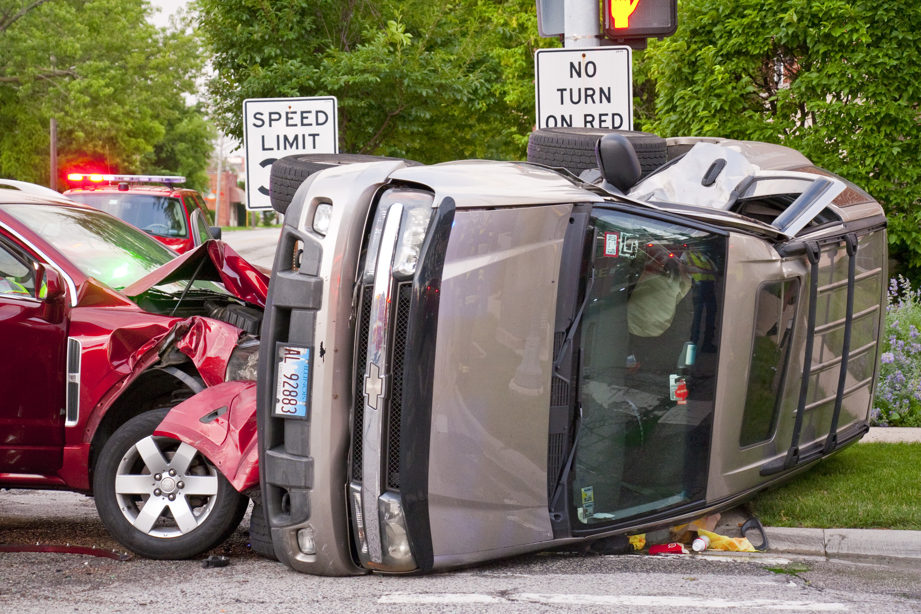
Defensive Driving & Life Survival Tips
Properly explained, this section is a semester long course. Here it is in @10 lines:
Visibility = survivability. Daytime Running Lights on the vehicle; High Viz Vest on YOU when outside the vehicle. In all traffic environments, including parking lots. The statistics pretty much prove this.
Distance = collision avoidance. The 4 second rule applies. That’s a ‘long way,’ until you’re in a situation.’ Practice keeping your distance in ALL environments.
Improper lane change — the leading cause of road-rage & fender benders
Failure to check rear before backing. Camera can help but in many cases, co-worker or driver, get out & LOOK. Use defensive parking when possible.
NO DISTRACTIONS. Daydreaming included. FOCUS on safe driving.
Speeding on 2 lane, undivided roads. GPS Tracking, remember?
Defensive driving is deliberate & conscientious. Summer raises the bar on incident avoidance. Avoid complacency. Most accidents occur @ 25 miles near home.

