Slide 1

May Safety Info
Spring Fever – Part B
Covid – Get Your Shot – Wear a Mask
Hand Washing Tutorial
Defensive Driving Reminders – GPS Units At Work
Safety in the Field

Slide 2

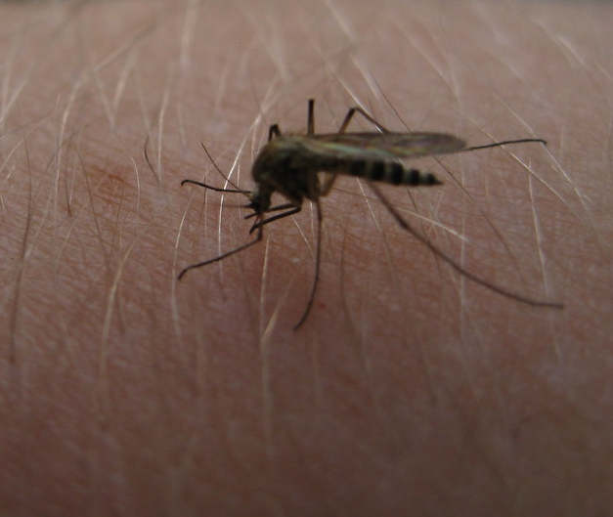
Spring Fever
Lasts Until @ July
Annual uptick in incidents of all types
Corelate with outdoor activity, rod trips, heat, stress, longer daylight hours, construction activity, etc.
Exercise heightened awareness & caution on all assignments, even the seemingly most innocuous.
Identify the obvious, potential or hidden risk factors.
Plan to eliminate or control them.
Otherwise, one of them will somehow bite you.
Practically ALL incidents are preventable.

Slide 3
Get Your Shot – Soon as Available
Avoid close quarter situations: sneeze, cough, loud laugh, shout, etc. – higher risk of spew. Mask up!
Mask also helps with pollen, dust, silica, smog, etc.
It is essentially a filter mechanism. Many state Health Departments require indoor use of face covering.
CDC: All that disinfecting & sanitizing, not such a big deal after all.
The Covid virus is spread via airborne droplets.
We now know: Hand hygiene is important but random contact surfaces are unlikely to cause virus transmission.

Slide 4
Hand Washing Tutorial
Keeping hands clean is part chemistry, part physics
Alcohol sanitizer alone does not typically remove much dirt from skin. But it will kill the icky stuff, and remove oil. Repeated use can ‘de-fat’ the skin, leading to other problems. Use hand cream to restore & protect skin.
Most detergent hand soap has a fractional % of sodium hydroxide (lye). This is a powerful disinfectant.
Lava, Dove, Ivory, etc. contain enough lye to scrub whatever germs are hanging on you. 20 second wash with ‘skin against skin’ is usually sufficient for lightly soiled hands.
Heavier dirt may need soft brush or cloth to set up abrasion. Soap lather lifts residue free. Rinse thoroughly.
Carbon Footprint reduction: skip the paper towel, air dry is usually sufficient. Totally avoid the blow dryer
Really dirty hands = repeat the wash process. Less soap is needed since there will always be a residue from the first wash.
Old mechanics trick: soap up the hands with bar or liquid soap and dab in a pinch of fine sand. The light abrasive will help emulsify and clean. This is basically how Lava soap works.
Foam soap disperses easier. Liquid soap will work but needs dispersal and a lot usually spills off.
For some reason, Dawn liquid soap is highly effective in a wide range of cleaning. A few drops and a water bottle = improvised cleaning station
Best Practice: Avoid direct skin contact when possible; wear proper gloves; use a tool for ‘no-touch’.

Slide 5
Defensive Driving
Post Covid Break Out
Road Rage incidents are increasing – correlate with rising air temperature. Neutralize attitude.
More traffic & debris on road – i.e., tire carcasses from overloaded TT’s, dorm room cleanout, etc.
4-Second following distance is recommended in all driving environments
Pedestrian, cyclist fatalities are increasing; give ample clearance
Intersections of all types are higher crash frequency locations. Use caution in & around intersections
Remember: GPS will report excessive speed and other anomalies
Chronic lead-foot disease may earn a driving safety course on your dime, a letter in HR file, performance review blemish, suspension of driving privilege, etc.
Posted speed limits are for passenger cars, daylight, dry road. All others, adjust for the circumstance.
Hands-free cellular; NEVER attempt to text or fiddle around with electronics while driving. Let passenger do the communications.
Leading cause of road rage = poor lane discipline; failure to signal; improper lane change
Backing safety = use a Spotter whenever possible; camera may not reveal all hazards.
Drive & park defensively; long, hot summer looms. Don’t take chances.

Slide 6

Field Ops Safety Advisory
Insects- explosive population growth from mild winter. Mosquito & tick - apply repellant spray to exterior garments. Check for ticks after field work.
Poison plant – identify presence; avoid contact or cross-contamination; use barrier crème, disposable gloves.
Slip-trip & fall: LOOK where your walk, step, climb. Adjust body posture for safe weight transfer on uneven surface.
Use proper PPE routinely – eye, face, hand, foot, head, High Viz, etc.
Practically all field work should have eye, hand and foot protection.
Crew Chiefs: lead by example
Traffic exposures require higher level of defense: high viz apparel, defensive parking & positioning, line of sight, work zone signage, Spotter, etc.
Take no chances! Your brother-in-law may not take such good care of your stuff in your absence.

