Slide 1


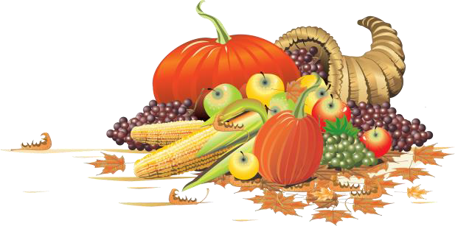
November Safety Info
Take Care re: Stress of Approaching Holidays
Winter Cold Weather Precautions
Deer Season — Extra Caution on Rural Roads
Weather Turning Cooler — Acclimate, Adjust, Hydrate
Vehicle Dynamics in Cold Weather
Load Carrying Advice
Slip & Fall Cautions

Slide 2


Extra care, compassion, needed during holidays
Thanksgiving is only a few weeks away. Along with shorter days….
Generally, stress levels increase around the holidays, for myriad reasons
Empathy is a highly prized attribute, particularly in these times.
There are multiple reasons for us to be thankful, even in adversity.
All persons handle stress differently. From irritant to trauma level, try to keep a balanced view. Stress can be managed.
Counselors generally advise to talk out an issue before it gets ‘under the skin’.
Confide in a trusted person to balance out an issue.

Slide 3

Prepare for the Approaching winter
The science is unclear but if the past 10 years are a guide the snow shovel will stay mostly under the deck.
We may not get a ‘pass’ entirely. The freeze-thaw cycle is actually more treacherous and destructive overall. We are still learning to adapt.
Highway drainage structure maintenance is critical, esp. on bridges, grades, turns, etc.
DOTs generally do a good job, but all drivers need to learn what to look for. Defensive driving measures in icy rain conditions for example.
On the roads: Snow-birds; inexperienced and distracted drivers, 4WD SUV’s on their roofs

Slide 4
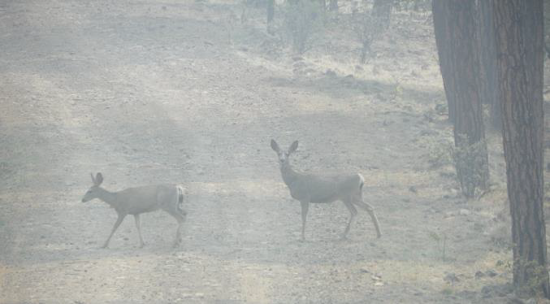
Deer season
Deer can show up practically anyplace, any time and are naturally camouflaged. Hard to see even in daylight.
The hazard is two-fold: the risk of hitting the animal is first, followed by you or other drivers swerving to avoid the carcass. Or for that matter, any object in the road.
If you see a deer and avoid it, be aware there are usually others in the vicinity.
Avoid the reactive tendency to make a sudden ‘swerve’. This can result in a far worse outcome than a deer collision.
Leave ample space (4 seconds) to vehicle ahead.
If you see sudden brake lights on vehicles ahead of you, immediately back it down. They may have seen or hit one.
•Infrastructure makes a difference. 2 lane undivided roads require extreme caution. Moderate speed to stay close to posted limit; shorter daylight hours –keep headlight lens clean; use high beam courteously.
•Safe driving is one defining trait of a conscientious employee.We have a good track record, let’s keep it going!

Slide 5
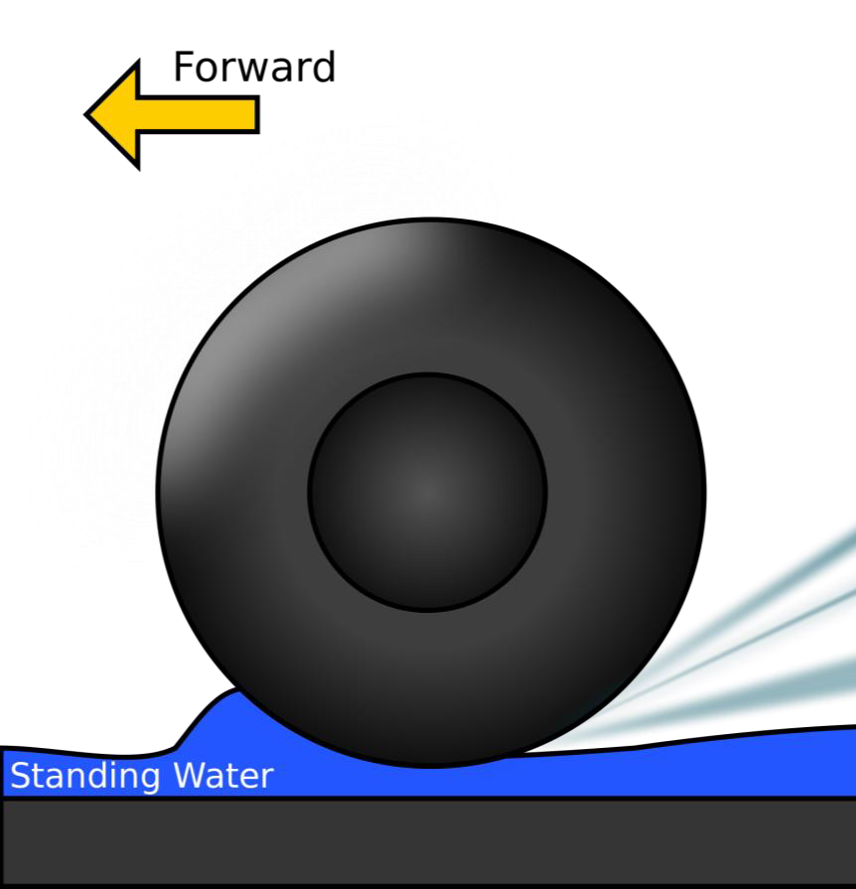
Vehicle Dynamics in Cold Weather
An empty or lightly loaded truck is less stable on compromised surfaces, i.e., tendency to hydroplane, less braking friction; steering on gravel , etc.
In most driving environments, this is not a big deal — until it becomes a big deal.
In cold temps, allow vehicle to warm up the cab a bit.
Avoid bulky garments while driving. NO HOODIES! They impair peripheral vision.
Carry spare washer fluid; ice-scraper, snow broom and de-frost/de-ice glass before driving.
If using 4 WD on highways, decrease travel speed proportionately
Bridge decks and flyovers will freeze long before the roadway–overnight typically
In snow, ice, sleet, rain –SLOW DOWN well before you need to take a turn. Avoid braking in a turn.

Slide 6
Winter: Hand & Finger care
Best Practice: a few minutes of light-gauge calisthenics before carrying gear, swinging a tool, etc. ‘Limber up’!
Blood flow to muscles is important for walking, stand, lift, carry, reach, grasp, etc. Dexterity is reduced in cold.
Dry skin is slippery-select the best grip type glove for the job,including driving a vehicle, tool handling, etc.
Range of motion is restricted by bulky garments. Dress in several light layers for best insulation from cold.
The body will begin a period of adjustment as seasonal temps cool down. Stay properly hydrated, maintain regular sleep interval,keep a balanced diet.
Be aware of upper body weight, positioning, balance, equilibrium, on uneven surface, slope, crossing ditch line, etc.
When possible, break a load down to smaller units. Or get some help. Or reconfigure the activity. DO NOT PUSH IT!

Slide 7
Slip and fall avoidance
Check your footwear. Worn edges – soles & heels – have less ‘grip’. On compromised surfaces, this can lead to SLIP, loss of balance.
Use the proper type of boot for site & weather conditions. High top lace-up for best lower leg and foot stability.
Be aware of upper body weight, positioning, balance, equilibrium, on uneven surface, slope, crossing ditch line, etc.
Use appropriate caution when carrying heavy or awkward loads on uneven terrain.
When possible, break a load down to smaller units. Or get some help. Or reconfigure the activity. DO NOT PUSH IT!
Soft tissue injury – i.e., strain, sprain, pinched nerve, etc. is avoidable.

