Slide 1
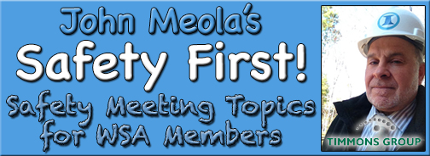
September Safety Info
Back To School Cautions
Deer Season Cautions
Blinding Glare Season
Participate in Close Call Reporting

Slide 2
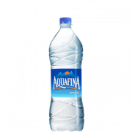
Back To School – Safely
Early AM school bus routes – be familiar with your route & crossings.
School zones and speed reduction times are typically posted and periodically monitored when in effect.
Watch for pedestrians and bicyclists at all times in and around school zones
Crosswalks marked & not – kids will walk practically anywhere
Commuter traffic increase due to bus driver shortage
Late afternoon – activities & athletics, stay alert in School Zones
Youthful Drivers – more than 2 persons in a vehicle could indicate a distracted driver. Give sufficient clearance
College students- hauling furniture on interstate in overloaded vehicle. Mattress, furniture & road debris resulting; fatigue or impaired. Stay Alert.

Slide 3
Deer Season - Driver Safety Tips
‘It’s that time of year’ – the deer population is very active starting around now.
Early AM, late afternoon, evening – use appropriate caution.
Known habitat areas are generally posted however this is not always reliable.
If you see 1 animal, there is usually a herd nearby.
Immediately slow down and scan for others. Deer are highly unpredictable.
Never swerve at speed on a 2 lane road to avoid a hit. There is insufficient margin of error. Immovable objects include trees, oncoming vehicles.
Decrease your travel speed for more perception & reaction time, shorter braking distance; and less damage if there is a hit.
As a general rule, DO NOT EXCEED 45 mph on 2 lane undivided road.

Slide 4
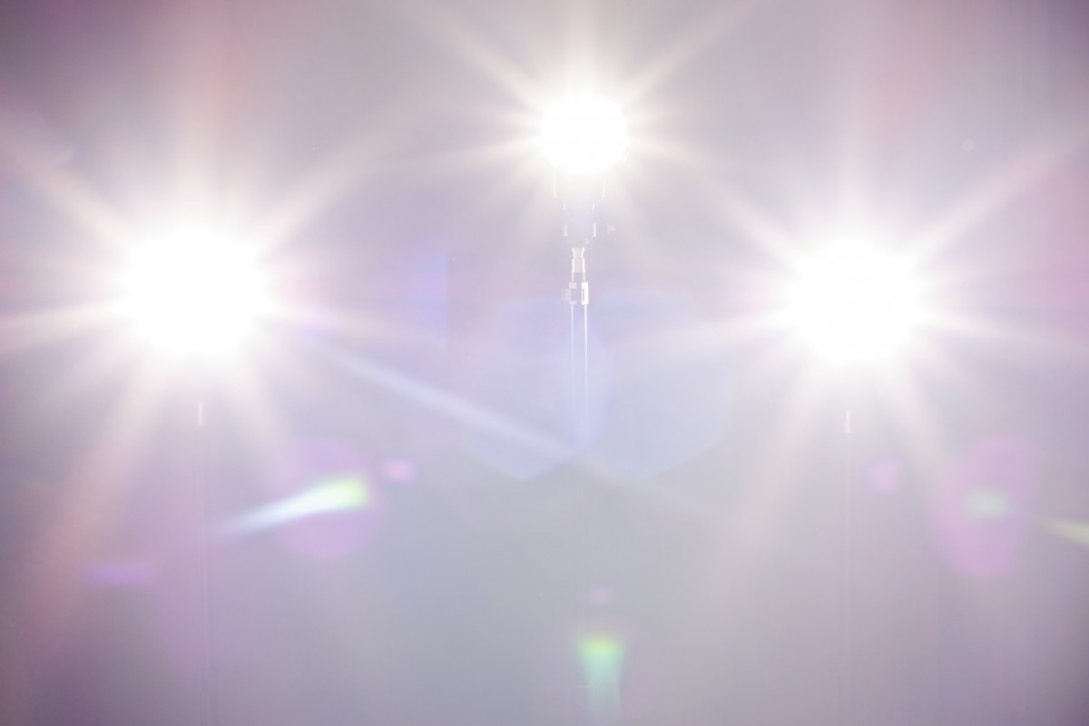
‘Glare Season’ Advisory
Blinding Glare is a serious hazard in early to mid fall and again in the spring
It will begin early AM and again through the afternoon.
This is also the time deer are most active. But no one told the deer about it.
Keep glass and mirrors clean to minimize distortion or visual impairment: If the glare is in your face, some adjustments to driving behavior are needed.
#1 SLOW DOWN; # 2 Get the Oakleys on; #3 Use the visor; #4 Try adjusting your position to offset the angle…
No amount of pedestrian high visibility will show up. REMEMBER: when the sun is at your back, persons /other drivers approaching may not even see you. Allow for safe clearance.
Double down in School Zones or populated areas. Early morning walkers, strollers, bikers, joggers, etc. are common; use appropriate caution.

Slide 5
Report Close Calls!
Report Close Calls- this is how our organization LEARNS TO PROTECT OURSELVES. Also known as ‘Lessons Learned’.
The Close Call you report today could mean an accident avoided next week.
Active engagement and pursuit of Continuous Improvement in our work processes are better indicators- ask yourself what SAFETY means to YOU?
Contribute your ideas for improvement at safety meetings, in the PPE section at Home Depot, the Tool Guy
Just because that’s the way it’s ‘always been done’ does not signify permanence or correctness.
Safety Suggestions? Speak Up!! There is always a ‘Better Way’ !

