Slide 1


December Safety Info
Examples of Tips by Meola’s Team
Defensive Driving in Winter Tips
Defensive Driving: A General Advisory
Tips for Winter Dress
Slip & Fall Awareness and Prevention
How to Spot a Risky Situation(s)

Slide 2
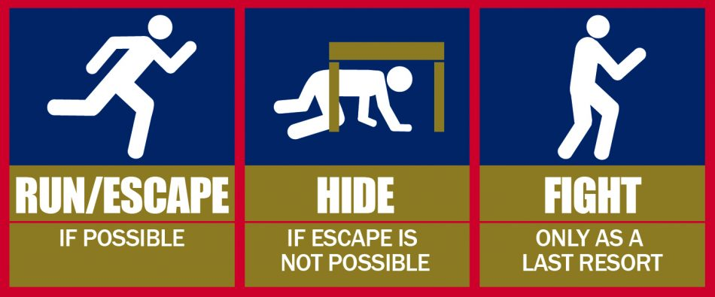

Examples of Tips & Close Calls offered by John Meola’s Team
Holiday travel – Remember to prepare for the 2nd most busy volume of traffic!
Active Shooter – Criminal activity increases, especially during late nights. Be extra cautious and keep in mind – stress & mental health issues
Using the parking brake is extra important during icy conditions
  Make SURE you are in ‘Park’ and brake is set before exiting vehicle
Keep your hands warm with hand warmer packets if need by. These are also available for shoes.
Use windshield de-Icer to reduce/remove the ‘glare factor’
  Use on all glass, mirrors, light lens, camera lens, etc.
  Stock up on washer fluid, de-icer
Be alert for signs of Hypothermia
  Grip strength decreases; dropped objects

Slide 3
Defensive Driving in Winter – 5 Keys +
Remember: Conditions will change over the course of a day
Remember – if the vehicle ahead has ice it may well blow off
Tractor trailer hazard – watch out for an ice sheet that may be on top
Warming effect of sun as day goes on – ice sheet dislodge & slip
Weight distribution on your vehicle – be cautious of stability when adding payload
Wet roads = wet BRAKES. Hard freeze overnight and brakes may develop issues to start. Light drag the brakes to dry off before parking.
Park defensively in case you need to jump start a vehicle; shovel out, etc.

Slide 4
Defensive Driving – General Advisory
Brake lights on interstate – Red Flag
  Brake lights on entrance ramp – double Red Flag
Cloud of dust & brake lights – take defensive measures
  Activate 4 way flashers immediately
  Activate warning strobes – maybe
  Move to safe lane position – flashers will negate directional signal
  Slow to safest speed – 4 second flowing distance - calculus
Distracted driver drift onto shoulder – will create flying object hazard
Be on the alert for large vehicle turbulence

Slide 5
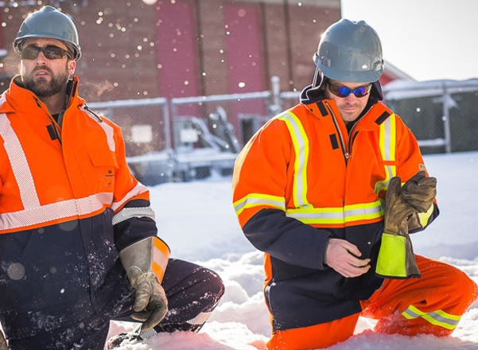
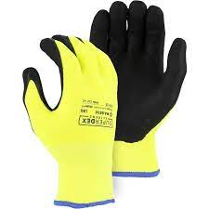
Winter Dress Suggestions
Several light layers – to adjust over course of day
Plan for variety and flexibility – outer layer, footwear, hand, neck, upper body
Helmet liner (strap in) with neck protector; fleece liners; gloves with thinsulate or other; hand warmers; thermal socks; long johns; bib overalls
Core body heat conservation – button or zipper garment front
Range of motion – i.e., snow shovel; materials handling; climbing; etc.
Air space retains heat – i.e., waffle pattern fabric; wool; loose garment layers
Outer shell garment – impermeable – rain, wind, etc.
Short-waist outer layer – rain drips onto trousers

Slide 6
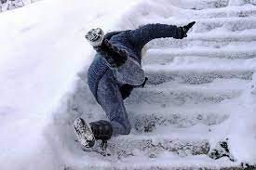
Slip & Fall Awareness & Prevention
Parking lots; sidewalks and walkways, aisles, paths, curb lines; poorly lit areas
  Keep entrance ways and other frequent use areas clear. Post sign for hazard – wet/ice etc.
Use caution when carrying objects on uneven or compromised surfaces
It does not take much to throw off the balance when walking surface is irregular, slippery, etc.
Change in elevation – steps – hills – incline – etc.
Use handrails when present OR adjust posture for stability
Use a long handle tool for improved upper body stability when needed
  60 % upper body weight is above the waist.

Slide 7
How to Spot a Risky Situation
Highly situational; use all of your sensory perception ( ‘Eyes & Ears‘)
Driving – weaving, overcorrecting; erratic; poor lane discipline; vehicle condition, front hubs; time of day; possible drunk driver late night; no lights, high beam lights;
Contractor vehicles late Friday afternoons; overloaded vehicles; poor general condition vehicles
Poorly or improperly marked rear surfaces; garden and utility trailers; overhanging objects – ladders, tools, wheelbarrows, etc. No trailer lights; overloaded vehicle and /trailer; speed & braking
  Antidote : back off, maintain a safe distance ( 4 second rule) take a defensive position
Report dangerous or suspect behavior; road hazards; some drivers will ‘weave’ to avoid a pot-hole.
Deer & large animal hazard; black Ice; freeze/thaw situations; bridge decks; pavement drainage impairments

