Slide 1


March Safety Info
March Madness & Spring Fever
Spring Brings Outdoor Hazards
Defensive Driving & No Distractions
Ergonomics — PPE — Glare — High Viz Apparel

Slide 2
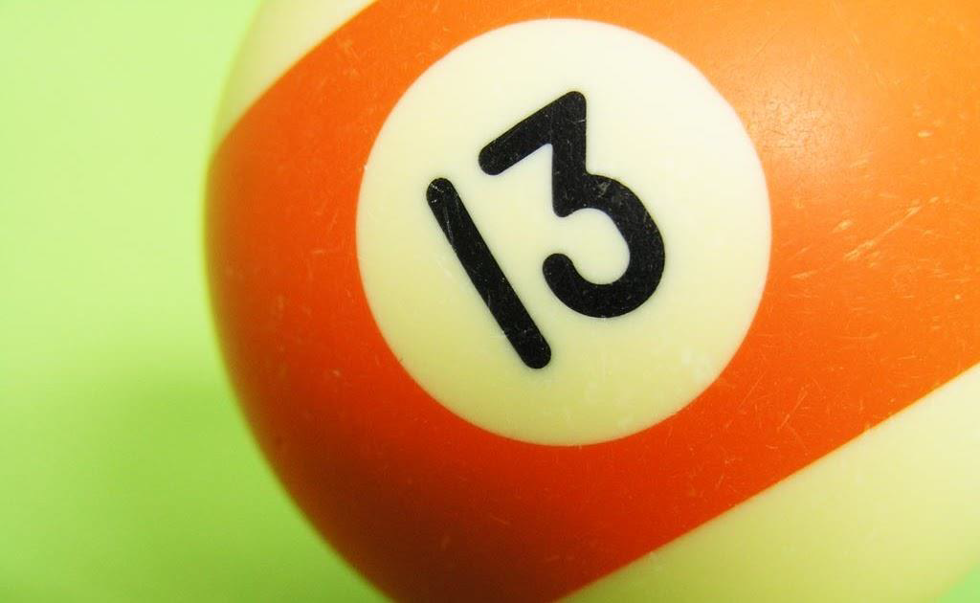
The Ides of March
‘Spring Fever’ is upon us a bit early this year.
It’s a time of year where there is a host of inexplicable phenomena
Take heed; double down; stay highly focused
Avoid distractions; think; calculate; plan.
It’s a time when outdoor activity increases, notably construction.
Remember: ‘March Madness’ is not about basketball or sporting event. When the sun comes back people make inexplicably erratic decisions.

Slide 3
Spring Brings Other Hazards
Spring is the time to start watching out for:
reptiles,
insects,
critters,
poison plants,
bees, hornets and wasps,
etc.

Slide 4
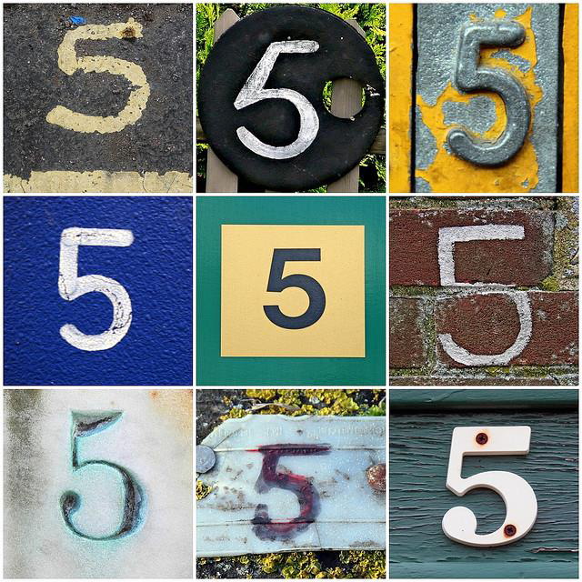
5 KEYS OF DEFENSIVE DRIVING
Aim high in steering
Keep your eyes moving
Make sure the other guy sees you
Always look for and leave yourself an ‘out’
Stay flexible: Changes in situations and circumstances create ‘alternate scenarios’

Slide 5
ergonomics & Spring Fever
Ergonomic physics = Force — Repetition — POSTURE
Keep your circadian rhythm in mind — watch out for ‘post lunch dip’
Stay hydrated
You have a body clock that adjusts when days get longer
Mind your diet — Whataburger and 5 Guys may not be the best for you
Quit or cut down on tobacco use
Spring brings a glare hazard: Easy not to see someone — keep glass and mirrors clean!
COVID — Keep up those hygiene lessons we’ve learned

