Slide 1


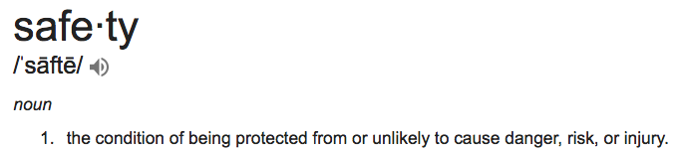
Happy Holidays
December Safety Info
Be Seen — Be Safe!
Weather — Another Nuclear Winter
Hand & Finger Injury Prevention
Defensive Driving
Holiday Safety

Slide 2
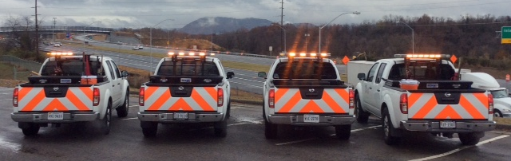
Be Seen — Be Safe!
Remember: the leading category of vehicle accident is ‘Struck From Behind’.
Vehicle conspicuity & Defensive Positioning are a key concepts in accident avoidance.
ALWAYS maintain a proper following distance — train drivers to follow the ‘4 Second Rule!’

Slide 3
Seasonal Change:
We’re Already Having Another Nuclear Winter
Deer Hazard — Watch out for deer & vehicle collisions. Harder to stop in icy conditions. Remember: Don’t swerve when that might create danger!
Colder temps — Plan for it – check your vehicle coolant, tire tread, air pressures
Dress in LAYERS of loose clothing for comfort; avoid wearing bulky outer garments when driving
Snow & Ice — driving hazard; plan for safe travel, carry extra WEIGHT on truck

Slide 4

Hand & Finger Injury Prevention
Recommended Practice: select the proper GLOVE for your task; usually you will want at least a couple of different types.
GRIP-enhancing gloves are preferred. Many different types. Check Home Depot
General advice: don’t pick up ANYTHING without your gloves on. We are seeing blanket requirements from GC’s for 100% glove use on the site.
They do this for many reasons. Lessons Learned, for example.
Dexterity, grip, protection. Wear GLOVES, avoid the ‘pinch’!

Slide 5
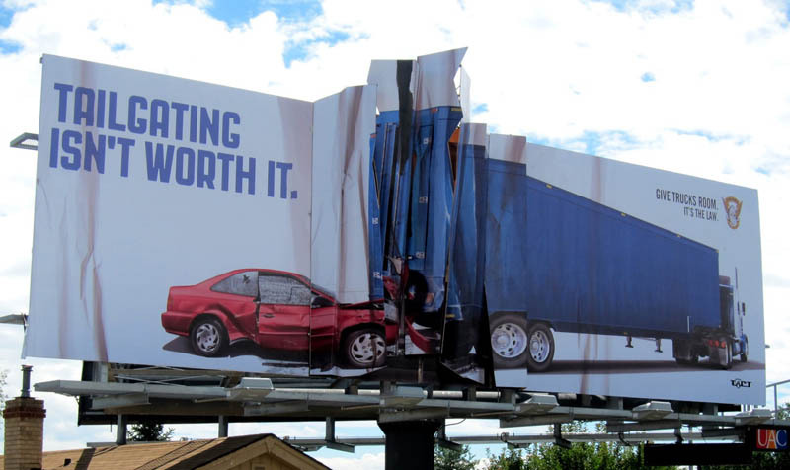
Defensive Driving Reminders
#1 = Keep a Safe Following Distance at all times, all roads.
4 Second Rule – this is a GUIDE to stay well back
LOOK 15 seconds ahead of you; adjust for possible incursions to your path
CAUTION at all kinds of INTERSECTIONS – this is where other drivers must make DECISIONS. Allow extra space for their poor choices.
Hazards: failure to signal; sudden stops; obscure line of sight; glare; wide turns, TAILGATING

Slide 6

HOLIDAY SAFETY REMINDERS
Hanging decorations can cause falls – use proper climbing hardware.
Electrical fires are common – be sure cords and circuits are not overloaded.
Check your home heating appliances, inspect/clean fireplace & wood stove.
Check smoke and CO detectors; confirm exit plans from upper floors.
Hot ash disposal – use proper safety when handling, storing, disposal.
Holiday parties- plan for Designated Driver

Slide 7

Summary
It’s up to each of us to LEAD our Projects in Safety
We are who set the standard of safety performance
Set the right example in all situations
Remember: Holidays can cause stress for many; understand and empathize
Protect yourself at all times on the job; especially while driving
Protect your family & loved ones with the same stringency
Happy Holidays & pray for a mild winter!

