Slide 1

February Safety Info
Winter Reminders; Driving and Otherwise
Ergonomic Comfort and Safety Reminders
Defensive Driving: Stay Calm and Check Your Vehicle
The ‘SPIDER’ Mnemonic

Slide 2
THE REALITIES OF WINTER…
Freeze – Thaw cycle: Results in ‘Pothole Season’
Watch out for: Truck ice blow-off
Safe following distance in all driving situations
Be cautious around drainage impairments & freeze over
Cold air is DRY – stay hydrated year ‘round
Use hand cream to combat dry hands

Slide 3
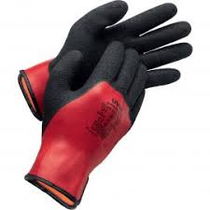
Ergonomics Tips & Reminders
Dress in loose layers — allows freedom of motion
Wear some type of glove to improve grip strength & retain hand heat
Footwear – change out to suit conditions
High Visibility gear – night lighting – glare

Slide 4
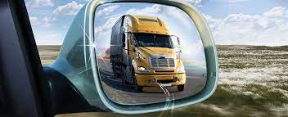
Defensive Driving
# 1 = Protective distance from other vehicles
# 2 = Backing safely – VOSH Reverse Operation Rule
Emotional Intelligence – Road Rage Avoidance – Lane Discipline
Mental health issues; substance abuse; criminal; self-harm, etc.
Vehicle related
Inspection – visual & under hood
Tires – periodic inflation check
Running gear – lights, strobes, visual surfaces
Wiper blades & washer fluid – make sure they see you!
Wear your seatbelt at all times inside the vehicle including when parked
Famous excuse: ‘I never saw them’

Slide 5
USE THE ‘SPIDER’ Mnemonic Similar to THE 5 Keys
Scan (Aim High in Steering)
Predict (Keep yer eyes moving)
Identify – (Make sure they see you)
Decide (Get the Big Picture)
Execute Response – (Leave yourself an OUT)

