Slide 1


March Safety Info
Watch out for the ‘Ides of March’
Reminder: Spring brings out the ‘critters’
Always important to remember the 5 keys to defensive driving
Ergonomics in the time of Spring Fever
March is ‘Ladder Safety Month:’ Follow these tips
Change your footwear with the seasonal change

Slide 2
Watch out for “the ides of march”…
‘Spring Fever’ is a real, if inexplicable, phenomena. It requires:
Avoiding distractions: Think; calculate; plan ahead; stick to plan
Stay highly focused on your task at hand
“March Madness” is not about a sporting event; rather, spring season brings about erratic behavior by otherwise normal people

Slide 3
Spring Brings out the ‘Critters’
Depending upon where you live, spring brings out an incredible variety of critters.
Watch out for whatever ones might be in your area including reptiles, insects, avians, bees, hornets, wasps and any poisonous plants.
Prepare ‘medical abatement kits’ for both vehicles and the office, if necessary.

Slide 4
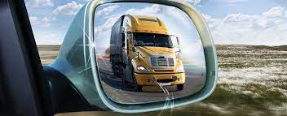
Practice the ‘5 keys of defensive driving’
1. Aim high in steering
2. Get the big picture
3. Keep your eyes moving
4. Make sure they see you
5. Always leave yourself an out
REMEMBER THESE ARE INTERPRETIVE KEYS. THEY CHANGE DEPENDING UPON YOUR SITUATION AND CIRCUMSTANCE

Slide 5
Ergonomics & spring fever
Stay hydrated year ‘round, not just in the spring as the weather heats up.
Hydrate with water, not Red Bull and similar
Remember that ergonomics is the understanding and application of physics: Watch your POSTURE!
Note your circadian rhythm; often, people have a ‘post-lunch dip.’
Spring has an increased number of glare hazards.
Clean your glass and mirrors so you don’t have to say “I never saw them.”

Slide 6
March is ‘ladder safety month’
Select any ladders you use for the job at hand:
Try to stay away from topmost steps
Make sure they are secure and stabilized before using
Remember: Ladders are an access device, not a working surface, and all fall protection rules apply
As you change elevation, watch your weight transfer and positioning

Slide 7
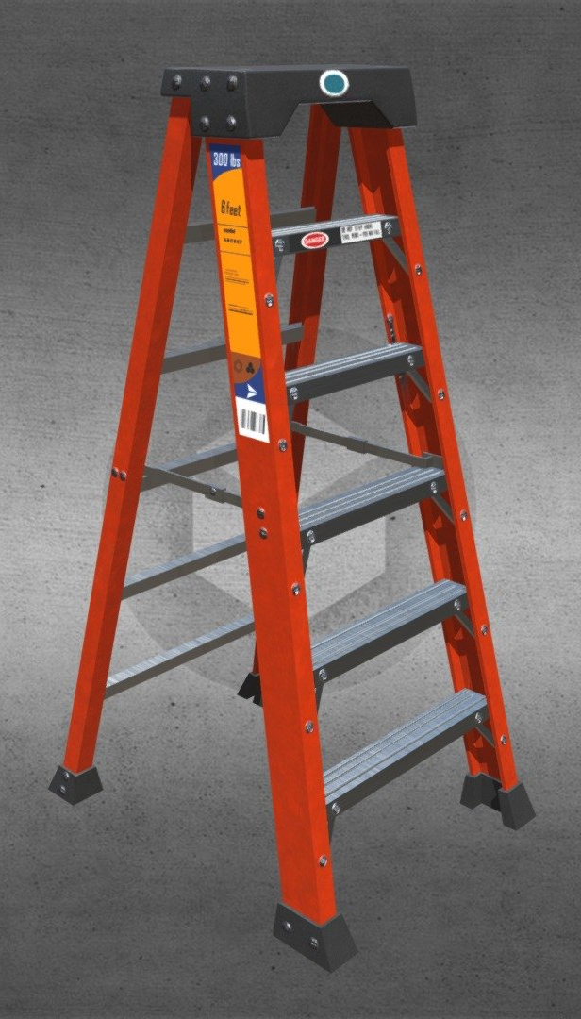
Wear correct footwear!
Watch the soles heel and edge wear of your shoes. Similar to tires they lose grip at the edges first.
Laces and eyelets can create a snag hazard.
As the season changes, so you may need to change footwear to guard against foot fatigue, foot health
On irregular surfaces watch where you’re walking and wear gloves!
Most falls occur by people tripping over their own feet on level ground, in doorways, corners and while carrying objects.

