Slide 1

November Safety Info
Glare Trouble Minimization
Report Accidents and Close Calls!
Thanksgiving Traffic: The Heaviest of the Year
Special Operations: Competency and Training
General Reminders About the Holiday Season

Slide 2

Glare Trouble Minimization
Glare occurs: Early morning - Late afternoon - All night
Be especially careful in known population areas
Keep a safe protective distance all around you – avoid swerving into other lane
Two lane roads – use extreme caution
Interstate – stay away from other vehicles

Slide 3

REPORT ACCIDENTS AND CLOSE CALLS!
Close Calls – when they happen… observe, record, report.
PPE – Seasonal gear. Layers are preferred to allow adjustment in temperature swing – use oversize high visibility vest.
Helmet liners are recommended; chin straps should be REQUIRED to keep your hat on when outside your truck in hard hat areas and jobs.
Eye protection can help keep your face warm, protect from blowing dust in eye, dry air.
Keep loose ends tucked in – draw strings, scarf, etc.
Nuclear Winter – keep a selection of light garments handy

Slide 4
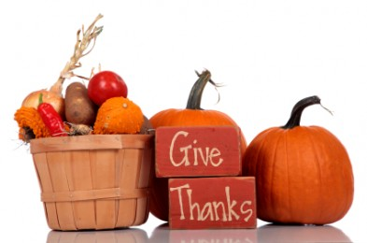
Thanksgiving Holiday Traffic Heaviest of the Year
Thanksgiving is the heaviest volume of all transportation.
We should be planning for the long holiday, probably call-out for incidents.
Big contributors to accidents: fatigue, distractions, marathon trips, unfamiliar routes, substance abuse, speeding - trying to ‘make time’, darkness hours, overloaded vehicles, road conditions, work zones, etc.
Not all drivers are ‘responsible’. Pressures build that can overcome sense of proper driving habits.
Safety Factors include: Seat Belts, Day-Time Running Lights, Defensive Positioning, time of day, volume, etc.
Remember: SATURDAY is statistically the worst day for crashes.
NIGHT driving increases risks; impaired drivers more common at NIGHT

Slide 5
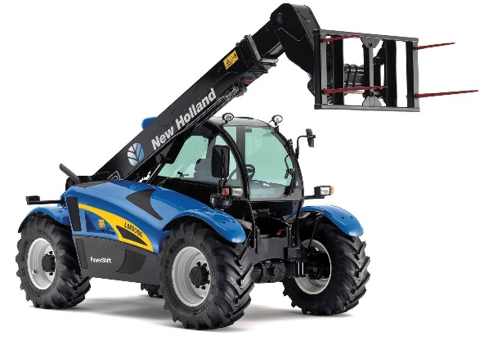
Special Ops – Competency & training
• Small stuff: chain saw, chop saw, angle grinder, skill saw, sawzall, etc.
• Battery operated tools – Ryobi chain saw for example
• More complex equipment – Lull; cherry picker; aerial lift; basket – license, training from dealer
• Specific training required: fall protection; confined space
• Common activity: lifting & handling; shovel, sledge hammer; post driver; manhole cover; upper body; legs
• PPE suited to the task
• Look at: weights and distance, forces, volumes, weather, etc. Ask yourself: “What could go wrong?”

Slide 6

Holiday Season
Home Safety review- decorations; ladders; trees; electrical;
Winter – check heating appliances; stoves, chimney; pipes; vents; filters; etc.
Check smoke alarms; CO detectors; other according to your location & activity
Vehicle emergency kit- flares; high viz vest; warning light; jumper cables; other
Weight in vehicle is important- weight distribution; tire maintenance
Celebrate responsibly; Uber or camp over
How to spot an impaired driver
No texting while driving, walking, work zone, etc. DISTRACTIONS ABOUND!

