Slide 1

October Safety Info
Deer Season Reminders
Glare Hazard Tips
Trick-or-Treat; Be Alert!
Cooling Temps = Body Changes
Defensive Positioning
Ergonomics

Slide 2

Deer Season – Moderate your speed
Early morning - Late afternoon - All night
Be especially careful in known population areas
Keep a safe protective distance all around you – avoid swerving into other lane
Two lane road – extreme caution; Interstate – stay away from other vehicles
Electronic deer whistles are supposedly more effective than passive traditional whistle
Pick them up at NAPA and put them on your family car and company truck.

Slide 3

Glare advisory
Low angle sun makes it hard to see the deer – or anything else!!
Such as kids crossing the street on way to school or other vehicles
Pedestrians – minimize your exposure. Cross at crosswalks only. Stay in protected areas
Drivers - Glare can be blinding. Use good quality sunglasses. Use visors.
Be aware that oncoming drivers may not see you because of glare, even with high viz garments
When outside your vehicle, stay in a protected area; stay well away from moving vehicles or equipment

Slide 4

Trick or treat – safely!
Try to stay out of traffic lanes; use lighted crosswalks; Take the kids to a Halloween party and skip all the running around.
When going house-to-house ringing doorbells – use appropriate caution in residential areas; accept only wrapped sealed candy.
Traffic safety for pedestrians – carry a flashlight; use high visibility or reflective markings; use lighted walkways when available
Costumes with loose garments can get caught on stuff; masks can obscure vision; use appropriate caution; supervise the exercise!

Slide 5
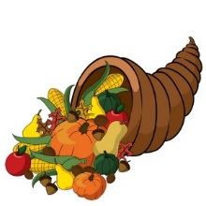
Cooler temps — physiological change starts now
Stay hydrated- cooler temps will start a month-long process of our blood thickening as a mechanism to help keep us warm.
Watch your diet – year ‘round, avoid junk food and sugary beverages.
Smoke less or quit; get adequate rest; daylight savings time will end soon; adjust sleep schedule.
Halloween; then Thanksgiving; thenChristmas
Just like that, 2017 goes by like a rocket!

Slide 6
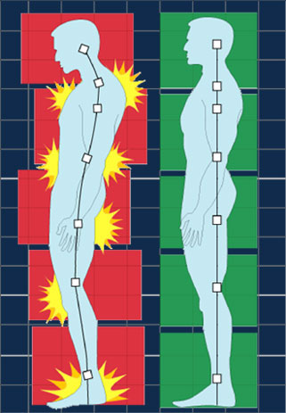
Ergonomics – all season- all activity
Force — repetition — posture — Caution when reaching above the shoulder, below the knee.
This is ‘out of position’ lift – adjust your posture; or, get assistance in the form of a ladder or step.
Raise the load mechanically – use leverage, hand truck, assistance, etc.
Adjust your seat and controls for optimal reach and grasp.
Tool use – every tool has safety instructions. Including how to hold and manipulate.
Know and follow the best practices; avoid hand & finger injuries; use grip gloves.
Never raise a chain saw or chop saw above chest height. That’s like asking for a serious hurting. Check your stance when getting on or off truck or equipment; keep hands free to grab and climb.

