Slide 1
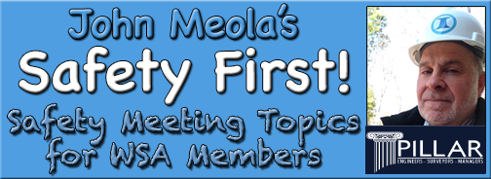
August Safety Info
Watch Out For School-Related Traffic!
Hurricane Cleanup Reminders
Deer Season Info
College Back to School Reminders
Preparing for Glare
Safety: Are You Prepared?

Slide 2
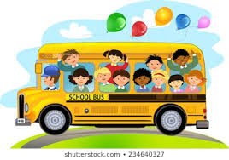
Watch out for kids and school buses!
School will soon be back in session so be alert and attentive for school bus routes and also the increased traffic associated with bringing kids to and from school
School zones are typically posted with a very low speed limit, which all drivers are advised to follow carefully.
Watch for school bus routes, increased traffic, vans and trailers with dorm room furniture, mattresses on road, etc.

Slide 3
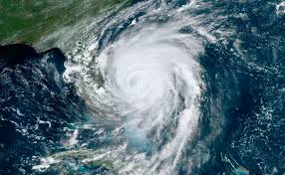
Safety for the hurricane zone
Most fatals and serious injuries occur AFTER the storm. Falls and chain saw incidents lead the list.
A downed tree has a lot of energy like coiled spring. Electrocution is also on the storm hazard list. Use extreme caution.
If there is no clear emergency, WAIT until things even out and return to normal. 'No heroics” is the best policy.
Avoid driving in high water when possible.

Slide 4
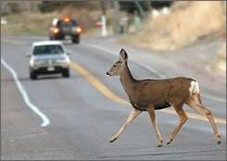
Deer on Roadway: ‘Tis the season
This annual recurring issue of deer season poses a danger to traffic in the fall.
Considering the risk and costs associated with a deer hit, if you’re in an area with deer consider having deer whistles mounted on all company vehicles.
Remind family members to be extra cautious as well.

Slide 5
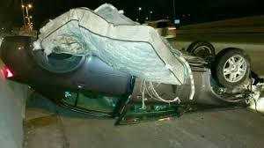
College back to school poses extra risks
Associated issues at this time of year include heavy traffic volumes up and down the interstate with college bound loads of furniture and dorm room fixtures usually poorly secured on the roof of a small vehicle in many cases overloaded to begin with.
Give these people a lot of clearance because those mattresses will fly and create a serious hazard.
This goes the same when you see any potentially unsecured load ahead.

Slide 6
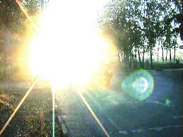
Prepare for glare
This is the time of year when we see the effects of increased glare in early morning and late afternoon. This condition can lead to glare blindness, in which case you could have a serious issue.
Use proper tinted lens and/or visor adjustment to help lessen the effect.
Safety Tip: if a driver is facing a glare blindness situation, there is actually no amount of high visibility apparel that is going to make you show up on their field of vision. The only preventive strategy is defense of positioning when you are on the ground.
Otherwise, when in a vehicle you need to be ready to make some instant decisions…

Slide 7
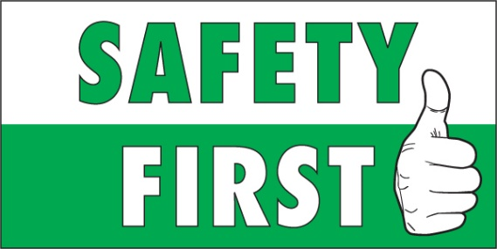
Safety: Are You Prepared?
Check your First Aid Kits
  Restock as needed
  Keep a bottle of 90% alcohol handy – use for cleaning, general purpose
  Keep a 4 oz. bottle of saline eye rinse, just in case
  Large size band aids – supplement your kit.
Chevrons on backs of trucks
  Leading cause of crash is rear end collisions
  Are headlights properly aimed and the lenses clear and not ‘foggy’?
  All rear facing surfaces – ideally affix red & white DOT tape
  New Drug Test Kits are available – saliva test, easy, fast, no doctors needed

