Slide 1


December Safety Info
Remember: Safety does not take the Holiday off!
Traditional Seasonal Safety Reminders
Cold Weather Safety Reminders
Cold Weather Ergonomics Reminders

Slide 2

Traditional Seasonal Safety Reminders
Fireplace & Wood Stove – check chimney, flue, piping; handle ashes properly – metal containers, away from combustibles
Electrical – avoid overloading; check wiring; outdoor use GFI outlets
Heating systems: check filters; clean or adjust – gas fired appliances need periodic cleaning of combustion chamber; check vent screens; oil furnace needs maintenance- nozzle and tank filter replaced, check low water cut off switch
Use the right ladder or device to climb & hang decorations
Be mindful of how house pets may interact with decorations, wiring

Slide 3
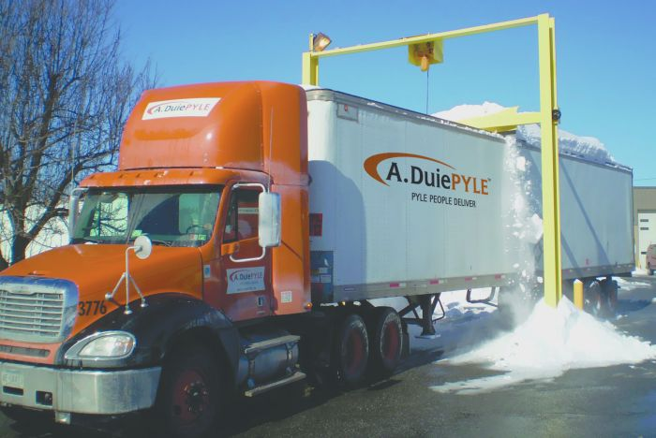
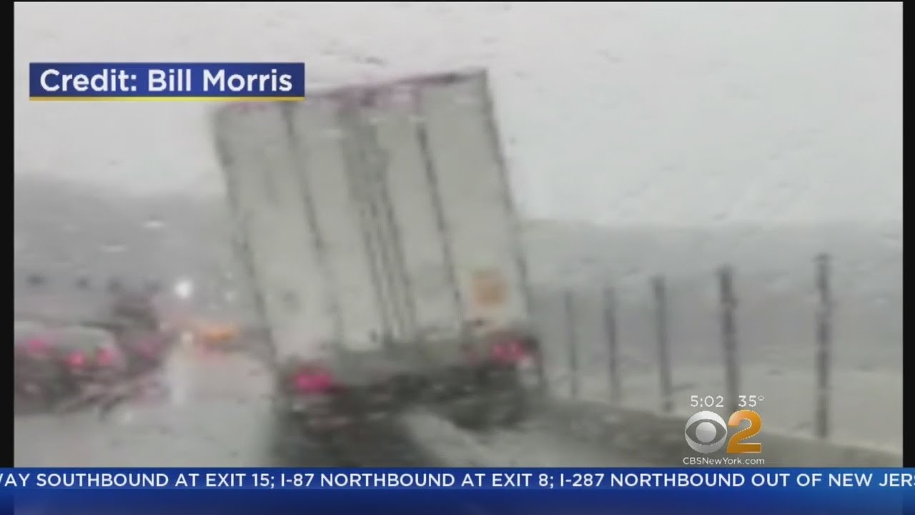
Seasonal Reminders
GLARE hazard in early AM and late afternoon – be alert for pedestrians
Animal Hazards- if the deer gets in front of you, DO NOT SWERVE – HIT IT
ICE – may occur overnight; bridge decks will freeze sooner
Truck Ice fly-off – keep sufficient distance in all driving situations
Use appropriate caution – ramps, hills, etc.
Use high visibility vest – watch out for pedestrians

Slide 4

Thankful for a Safe Year Past
Be mindful of the Future
Holiday Party - Designated Driver when appropriate or call Uber
Remember the 5 Keys of Defensive Driving
Aim High In Steering
Get the Big Picture
Keep Your Eyes Moving
Make Sure they See You
ALWAYs leave yourself an OUT!
  Most critical when family in the car
  Avoid late night driving when possible; bars close; parties break up
  Inclement weather – temps fall when sun sets
  Melting ice will freeze on ramps, bridge decks

Slide 5
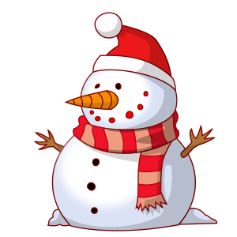
Cold Weather Safety
Above average precipitation spells misery for many locales
Cold weather dress: LAYERS of loose fabric hold warm insulating air
Extreme exposures, long term, wind chill, plan accordingly
Keep head, neck, chest, torso protected.
Cover mouth and nose; protect eyes from wind
Use caution when sledding, skiing, outdoor winter sports or recreation
Snowmobile or ATV in woods, etc. Ice – freeze - pond – water safety

Slide 6
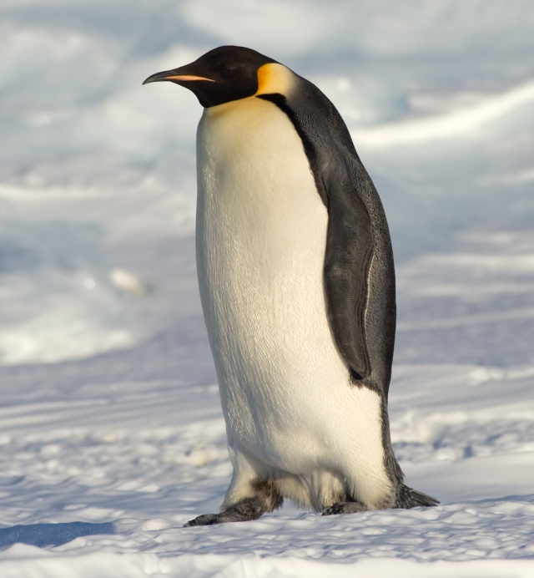
Cold Weather Ergonomics
Stay hydrated- if for no other reason than it helps body ward off colds. We will have a flu season; consider a flu shot.
Avoid greasy fat junk food; this causes body to work a lot harder to digest.
The colder it is, the more calories we will burn
Big breakfast and lunch will get burned off.
Night time meal should be balanced and timed to allow restful sleep
Coffee and Red Bull only will work for so long to keep you awake, much less alert.
Plan for proper REST intervals
Stay back from plow drivers
Remember: Fatigue kicks in unannounced.

Slide 7
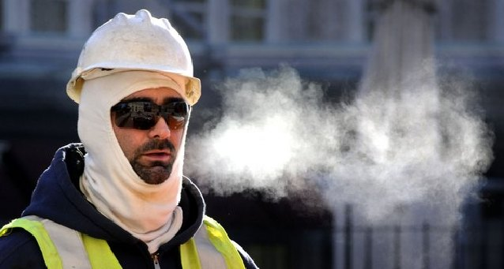
Cold Weather Ergonomics, continued
Do some warm up exercises before physical exertion
Wear appropriate clothing for the task – i.e., shoulder & upper body rotation; high performance recreational gear works well
Use knee padding – elbow, head protection as required
Helmet liner is very good to retain heat
Caution with loose drawstrings, scarf
Select footwear suited to the environment

Slide 8


Happy & Safe New Year 2025 !!
Start thinking of resolutions for 2025…
See how long they last!
One RESOLUTION we ALL need to make is to be mindful and deliberate when it comes to our Safety

