Slide 1


January Safety Info
Epic COLD!! General Arctic Safety Tips & Advisories – how to dress to stay warm
Winter Vehicle Prep Reminders
Reminder to Mitigate Ice/Snow Around Offices and Client Offices
Dressing and Other Tips for Cold Weather
Defensive Driving – Seasonal Best Practices

Slide 2

Extreme Cold
We have to adapt. Last year at this time it was in the 50’s and above in most parts.
Dress for the exposure – if you will be outdoors for extended periods, several layers of insulating clothing are advised.
Long johns; union suit; insulated bibs or coveralls, etc.
Remember, most heat loss is from upper body: vest, wool, flannel, scarf, helmet liner; fleece.
Avoid standing directly on cold pavement.
Use cardboard, plywood, etc. to insulate from cold surfaces.
No loose ends- drawstrings, scarves, etc.
Helmet liners, tuck straps.

Slide 3
Winter Vehicle Maintenance
Check your vehicle running gear for winter — i.e,. Long-handled snow brush; ice scraper; de-icer; wiper blades
Use WD-40 or similar on door seals, door locks, pad locks, other mechanisms, etc. That treatment will resist freezing.

Slide 4

Reminder to Mitigate Ice & Snow
Around YOUR Offices and Client Offices
Preseason maintenance- CLEAN THE GUTTERS! This prevents ice build up, which can tear the gutters off the building.
Be aware of icicles build up on the eaves. Melting roof snow and ice will gradually form icicles overnight. Just closing a door may dislodge icicles!
Ideally all personnel entrances will be PROTECTED with some type of canopy, roof or other sheltered area. Ice falling from eaves can cause serious injury, be aware of it.
Plan for keeping walk ways clear. Look for low spots on pavement where poor drainage will create icy spots. Apply sand or warning. Keep a bucket of salt/sand mix handy.
Use a cart or wheelbarrow to move materials – carrying a heavy bag of salt on icy surfaces is asking for slip & fall trouble.
Report icy conditions to facility management – to help avoid accidents.

Slide 5
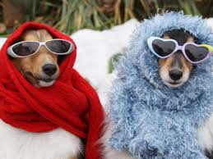
Cold Weather Ergonomics
Dress for Success
(Warmth & Comfort)
Warm air trapped between layers of clothing helps insulate. Waffle pattern or wool fabric is good.
Glove material is important. Insulation is important because extremities will lose heat faster. Bulky gloves decrease dexterity so you may need several pair to select from.
Keep spare gloves warm when possible for a change out if needed. Cover exposed skin as much as possible – use lotion
Shoe inserts, liners, double layer of socks.
Exterior clothing should be wind resistant & insulated. Allow extra size-up for range of motion and mobility; avoid tight fitting garments.
In the vehicle- usually a bulky coat is not needed since cabs will warm quickly. Use driving type grip gloves.
Avoid wearing a bulky hat when driving. It can impair drivers vision.
Use hand crème, lip cover, other skin protectant. Cold air is usually very dry.
Extreme exposures: use dust mask or ‘muffler’ to avoid breathing in directly cold air..
Wear eye protection or goggles to protect and minimize heat loss around the eye.

Slide 6
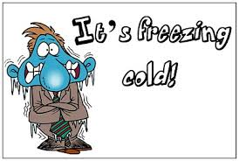
Ergonomics of Cold Weather
Do some warm-up ‘limbering up’ exercises before physical activity
Even tossing a trash bag into a dumpster can cause a shoulder strain
Use correct posture; heavier weight, get assistance; reduce size of load
All those clothes you are wearing can cause constriction and limit range of motion, such as when climbing steps or a ladder.
Stretch arms, legs, upper body rotations, neck rotations, etc.
Select the best glove for your task. Short term exposure to cold does not usually require heavy insulation; high grip type gloves are preferred

Slide 7
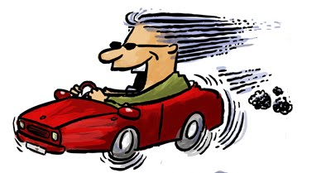
Defensive Driving
Don’t Leave Home Without it!!
Leave minimum of 4 second following distance to vehicle ahead of you.
Be alert for Ice on roadway – bridge decks, certain other pavement configurations; slow down; do not try to rush.
Do not be pressured by other drivers.
Avoid non-essential driving in snow & ice.
Carry extra weight amidships in winter for stability.
Check your tires – pressure and tread.
If stuck in deep snow – keep exhaust pipe clear.
Keep an emergency kit in the vehicle for winter – check AAA web site.
Newer roads are generally safer than older roads – better drainage, pavement, guardrails; alignment, line of sight, etc.

