Slide 1

June Safety Info
National Safety Month Safety Tips
• You Tell Me: Had any near misses? How can we do a better job of safety?
• Heat-Related injury recognition and action
• Had a tetanus shot lately?
• Say “Cheese:” Expect any and all of your actions to be caught on cell phone

Slide 2

Near Misses / Close Calls / Accidents
Does anyone on the Team have a near miss / close call / accident / cautionary tale that they would like to share?
Any ideas on how we can improve our safety in any area?
Let’s work together to stop all avoidable accidents…

Slide 3
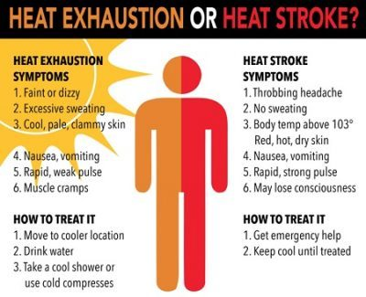
Heat-Related:
Heat exhaustion or heat stroke?

Slide 4

First Aid Measures for Heat
Call 911 if disoriented or un-conscious. Cool person down, preferably in cold water to the neck. Keep applying cool water, air, shade etc. until ER has arrived.
Take to a cool spot, remove clothes down to underwear, cool with water or cool cloths, place fan or air conditioning around the person to dry up moisture, place ice packs around the neck, armpits and groin area, give plenty of water unless throwing up.

Slide 5
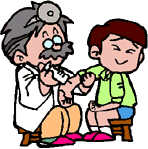
When the last time you had a tetanus shot?
Normally, however, boosters are for tetanus and diphtheria (Td) alone. Authorities also recommend a booster shot if you get a particularly nasty open wound (a laceration, penetration, or avulsion) if it has been five years or longer since your last tetanus shot.”
This is not an OSHA requirement but something to think about looking into.

Slide 6

Say “Cheese!”

Slide 7
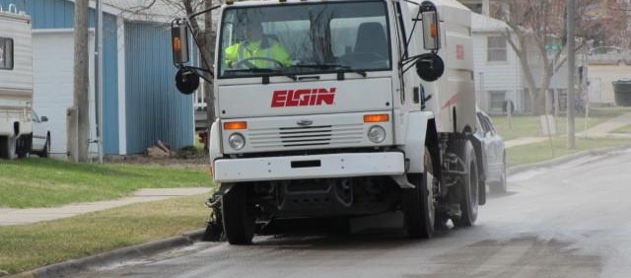
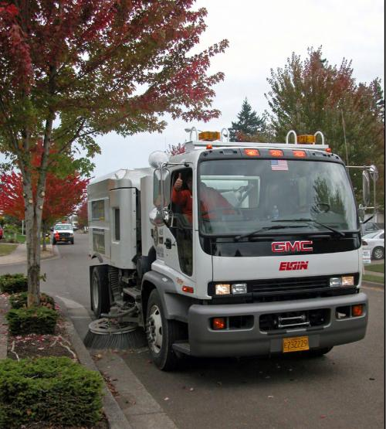
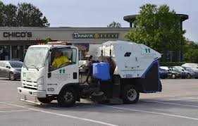
With one quick Click – You’re On Camera
Remember: These days nearly everyone has a cell phone. Always be prepared for the possibility that any of your actions will be caught on camera!

