Slide 1

March Safety Info
March Madness – Get Ready For It
Defensive Driving During March Madness
Safety Committee Ideas
Hydration
Behavior and Accident Causation
General Ergonomic Reminders

Slide 2

“March Madness”? Not on our watch!
This phenomenon did not earn it’s name out of idleness – it’s a real problem. And it’s not about basketball.
March is famous for weird stuff happening. Keep a close eye on it.
Daylight hours becoming longer – more to do- schedules bulk up –
activity – drama, etc.
DO NOT BE DISTRACTED! There are already enough distractions to go around.
In light of the unusually warm winter, we should be prepared for freaky Spring weather.
STAY FOCUSED! March is a long month.

Slide 3

Defensive Driving During march madness
Distractions are real. Texting while driving is real.
DUI; inexperience; fatigue; drug use; NIGHT driving & work zones; other impairments; ‘crazy’ drivers come out of the woodwork in MARCH!
Our preaching today is aimed at Defense & PREVENTION
In most areas traffic crashes going UP; fatalities going UP; work zones, UP
Think. Plan. Ask yourself ahead of time: What could go wrong?
Avoid the exposure; minimize your exposure.
Park – walk – stand in PROTECTED AREAS when possible

Slide 4
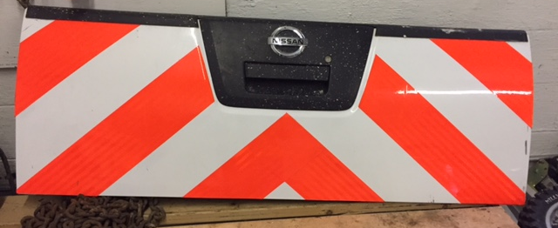
Safety Committee Ideas
Consider adding a reflective band to your hard hats
When the heat starts, get protectors for the neck nape
Watch out you don’t hydroplane on wet roads – moderate your speed. Even a film of water on the road can cause loss of traction.
Check your tread wear pattern and tire inflation. Spring rains may be torrential. Keep weight in the truck bed.
Practice “Continuous Improvements” — name them to keep track and add value!
Are your vehicles equipped with tailgate warning tape

Slide 5
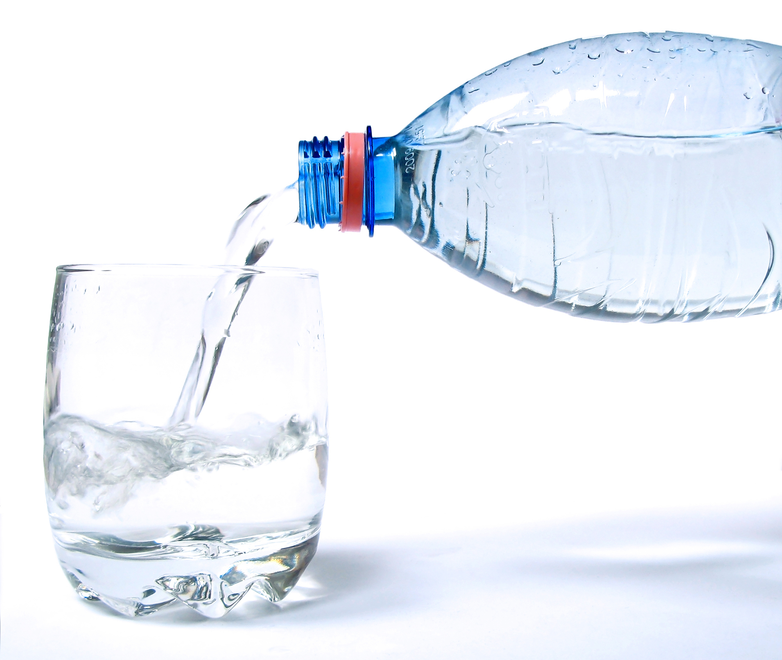
Hydration – Circulatory System Stress
Blood will start to THIN OUT for warmer temperatures
Assist this process with proper hydration. Stay out of the soda aisle; avoid ‘Big Gulp’; junk food & drinks
WATER is preferred with 50% Gator Ade or Squincher; fruit juice; other natural beverage
Salad, fresh fruit, etc. Skip the fried stuff.
Best Thing Ever: refillable water bottle!

Slide 6
Accident causation – behavior is key
Human Behavior is the key element in accident prevention. It is also highly resistant to change. We’re all geniuses, right?
Hardware rarely fails. Ladders rarely break. Vehicles do not over-speed by themselves. Phones do not force you to look at them while driving.
In other words, prevention is a control issue. YOUR behavior control.
Personal Risk management = Do not create an exposure where none needs to exist.
Do not prolong an exposure for a millisecond longer than it needs to be.
Take every reasonable precaution to protect yourself. That is a question that will be asked during any investigation.
Our insurance company will ask the same questions when making a decision on disability or survivors’ benefits.

Slide 7
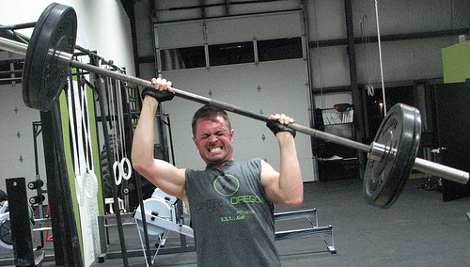
Ergonomics – It’s what keeps you goin’!
3 Basic Elements: Force - Repetition – Posture
Good POSTURE is the most important.
Knees higher than hips when seated, driving.
Avoid slouch; proper footwear; PPE – grip gloves, knee pads, etc.
THINK before handling heavy objects. Poor lifting habits will lead to chronic back problems.
Get help with heavy stuff. Avoid over the shoulder reaching. Raise a heavy load with leverage, not brute force. Use tools, hand truck, etc.
Examples of good ergo: use 3-Point Stance when climbing; use walking stick on uneven ground; take shades off when not needed for glare; eat right; stay hydrated; dress right; good boots; sleep right; don’t text and drive…(ok, not really, but it can hurt you in other ways!)

