Slide 1
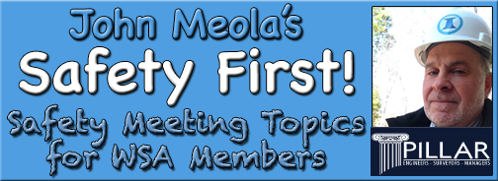
September Safety Info
HURRICANE SEASON (as if you hadn’t heard…)
Post storm recovery advice for those in ’hurricane zone’
Practice defensive driving all the time; here’s how
Hand and finger safety reminders
Remember to report ‘close calls!’

Slide 2
Severe weather safety practices
We usually have a pretty good LEAD TIME to plan for storm arrival
Most people have brains enough to shelter safely during the event.
Post Storm recovery is when the most fatalities occur. Among the top ten causes:
Trying to cross flooded areas in a vehicle or on foot – results in drowning
Flowing water up to your knees can knock you off your feet
Electrocution – downed wires in fallen trees; other electrical contact
Chain Saw injuries – very common; very few persons follow safety rules with chain saws
Falls from weakened structures;
Collapse or struck by – trees, structures, infrastructure, other
Vehicle accident – no power to traffic signals; no lighting; vehicle roll over & ejection; no seat belt
Remember: hospitals may not be functioning in hard hit areas; EMS may not be available; you are on your own.
Secondary risks: sanitation & health conditions, contamination, dehydration; fatigue, etc.

Slide 3
Post Storm Recovery
Plan for power interruption. Back up generator is handy. Plan for re-fueling safety, ventilation for exhaust; fire extinguisher; electrical safety; use HD grade extension cords; check the routing – avoid pinch or chafe cords; avoid overload on generator; overheating of motors
In extreme cases: Pre-stock food and water with long shelf life; coordinate storage and fridge or freezer for perishable foods; consider MRE’s from sporting goods stores; camping supplies for cooking, sleeping, sanitation and hygiene, washing, laundry, etc.
Load up on batteries, alternate power sources such as hand crank radios and lights; tarps, duct tape, rope and twine, tools for clearing debris, safety gear, sanitizer, work clothing, rugged footwear
If in low lying areas, figure out how to protect your stuff from flooding – raise it up higher, build sand bag berms; relocate; waterproof, etc.

Slide 4
Defensive Driving – Storm or Not
Practice the “5 Keys” – Aim High! Leave 4 second following distance -
In areas where power is out, use EXTREME CAUTION in and around signalized intersections. There are no rules governing who goes where, when. We had a fatality last year in Richmond during blizzard, signals not working.
Avoid high water. The bottom of vehicle is sealed and will ‘float’ the vehicle like a tea cup. Including 4 wheel drive and SUV’s etc. Pick ups, add weight for stability. Hub cap height water is the limit.
Check wiper blade condition; check fluids under the hood; check tire pressures, check spare tire
Top off fuel tank; use caution if transporting portable gas cans, cylinders, etc. Secure against spillage; check fire extinguisher; fire blanket
Be aware of static electricity discharge - do not fill container on truck bed or vehicle – place on ground
Keep speed moderate in storm conditions; animals and critters may be displaced and get onto the road
Be alert for OVERHEAD hazards such as leaning trees, hanging limbs, etc.
You will encounter debris on the road. Fallen trees may have power lines tangled in them, do a survey before jumping in to cut your way out.

Slide 5
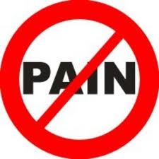

OUCH! Hand & Finger Injury Avoidance
Wear the right glove for the job. Even a rag will protect.
Use a tool, not your bare hands. Let the tool do the work.
LOOK for pinch points. Protect against crush, cut, pinch, etc.
Know what you are handling: can it move, spring, drop, release, etc.
Get assistance if needed. Rarely is the job an emergency.
Stay in protected areas, be ready to move, leave yourself an ‘OUT’.
Use correct posture when exerting high hand force. This can prevent strain or sprain.
Make sure you have good grip when lifting and handling. Use a Vise Grip plier or clamp
“It Slipped” is a common explanation on hand injury accident reports. Learn from it.
Keep your first aid kit handy; check that it’s up to date. Ice, elevation, Ibuprofen.

Slide 6
REMEMBER: Report Close Calls!
Report Close Calls- this is how an organization LEARNS TO PROTECT ITSELF. Also known as ‘Lessons Learned’.
The Close Call you report today could mean an accident avoided next week.
Active engagement and pursuit of Continuous Improvement in work processes are better indicators — ask yourself what SAFETY means to YOU?
Contribute your ideas for improvement at safety meetings.
Just because that’s the way it’s ‘always been done’ does not signify permanence or correctness.
Safety Suggestions? Speak Up!! There is always a ‘Better Way’ !

