Slide 1

February Safety Info
Nuclear WINTER continues
ICE & Cold – SLICK roads – Defensive Driving
Hydro-Plane Advisory
Ergonomics for cold – hand & finger, shoulder and arm strains common
Flu Season Advisory

Slide 2
Freeze /Thaw & Infrastructure= Lifetime Employment
We’d be better off without it, but this is another Nuclear Winter
Black Ice; rime, frost, melting runoff accumulates on ramps as temps fall, etc.
We need to be alert and aware for the condition – for example, watch out for ice on on/off ramps/bridges
Carry extra weight on truck; moderate speed in advance of a turn
LOOK for signs of icing: spin outs, wrecks and debris – all indicators of hazard
Truck ice blow-off and icicles on eaves can be dangerous. Also remember that water in gas lines freezes
When passing vehicles, especially semis, be cautious or spray will blind you. Pick a safe place to make the pass, try to find a straight dry stretch, NOT in a curve.
Check your wiper blades. Carry refill washer fluid.
Extra WEIGHT up against cab, 5 gallon cans of sand, etc.

Slide 3
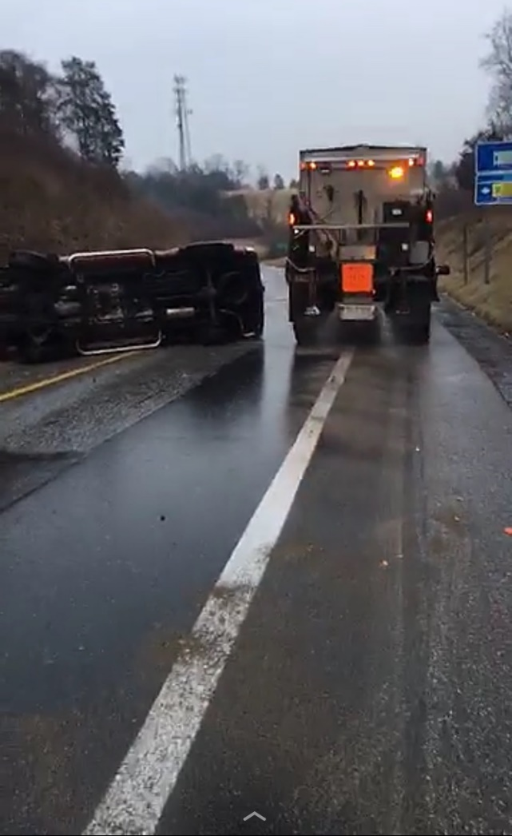
Example of where not to be in ice storm…
For a variety of reasons, some locations will freeze faster than others
We should learn where these ‘cold spots’ might exist and take measures to protect ourselves
Low lying areas, bridge decks, canyons, gullies, steep terrain, drop offs, other unusual topography, piedmont regions, hilltops, near large bodies of water, etc.
Freeze is predictable to some extent by calculating weather maps for surrounding areas, but in a Nuclear Winter, all bets are off. Use extreme caution.

Slide 4
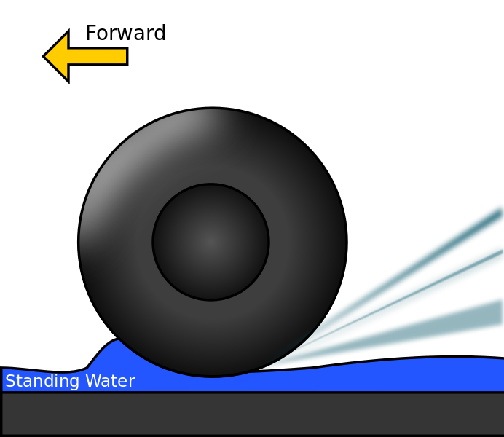
Hydro = Water & PLANE = FlyING
Even 1/16 inch of water on road can cause loss of traction.
Steering and braking efficiency can go right out the window
SLOW DOWN; carry extra weight; check your tires – the wide grooves are meant to shed water at speed. All of these elements may be compromised to a degree.
Water does not compress. Your tires will literally ride ON TOP OF the film of water. That’s scary at any speed, much less above 60 mph.
SNOW & ICE MELT on roadside and ramps can impair natural drainage patterns on the road. This melt water can freeze at dusk when temps drop.
Older roads may have more rutting in wheel-paths creating depression. LOOK for surface water entrainment and avoid when possible
NEWER roads or resurfaced may be less susceptible; use caution

Slide 5

Ergonomics in Cold Do some stretches to warm up muscles
Warm up before climbing, hiking, lifting, and physical activity.
Bulky garments can impair range of motion – limber up
Muscle flex and upper body rotation will increase blood supply, make you more supple and less susceptible to strain or soft tissue distress
Use layers of light clothing to insulate; outer layer wind and moisture resist.
Use vents, zippers, buttons, etc. to permit air circulation, avoid build up of water vapor; stay well hydrated;
Take frequent rest breaks during prolonged physical activity – avoid marathon shifts of duty
Advanced fatigue will cause sleep micro-burst, there is no prevention.
Plan for regular & restful REM sleep. Avoid using caffeine or Red Bull, etc.

Slide 6

Flu Season Is Now – and it is becoming troublesome
Bird Flu, Swine Flu, Hong Kong Flu, Asiatic Flu, take your pick, they will all make you SICK
Best Defense: Hand Washing; avoid close contact with sick people. Get Your Flu Shot!
Wear face and/or eye protection in crowded places. Fact: most cold & flu virus enters the body thru TEAR DUCTS.
Antidote: don’t rub your eye with your bare hand, use a tissue; you might even wear the otherwise absurdly impractical ski goggles
Use hand sanitizer, wash hands frequently, watch what you come into contact with, etc.
Avoid any contact with animal, bird, rodent, reptile, etc. lairs, nests, burrows, droppings, debris, etc. Removing a carcass from travel lane- use a tool, rake, hoe, pitchfork, shovel, gloves, -- never bare hands.
Kids in school? Guess what. More hand washing, less hand shaking.
Wear gloves when in contact with things like door handles, stair railings, common use items. Cover your nose and mouth when sneeze or cough
Extreme case: Wear N95 paper respirator with exhalation valve when hanging around crowded places.
Avoid crowds. Almost impossible to achieve, but at least you know what you’re up against.
Some persons systems more resistant than others. Drink OJ, stay hydrated; take Zicam or equivalent at onset of symptoms;

Slide 7
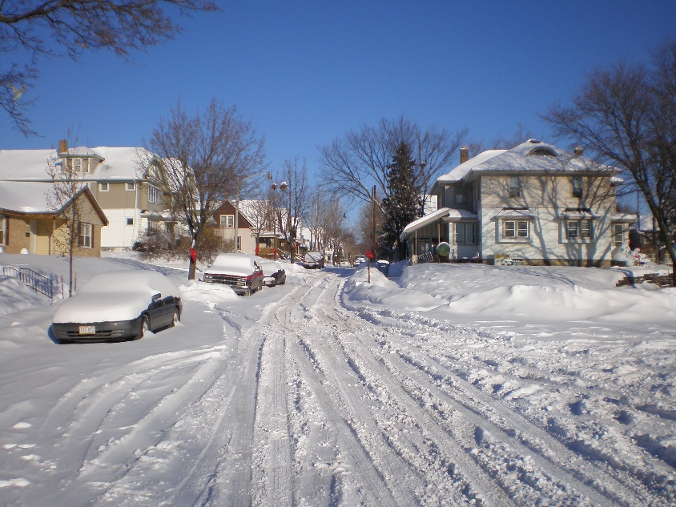
Winter Safety Tips some General Info
Extreme Cold- check your heating system – it’s working overtime
Keep drinking water on hand – pipes freeze
Critters will try to find warmth in your house – basement, crawl spaces, etc. Use screen mesh to block openings.
If stuck in snow in vehicle – be cautious while engine is running for heat. Keep tailpipe clear to allow exhaust to disperse. As few a 4-5 inches can disrupt air flow under the vehicle
Frozen ice ruts can cause undercarriage damage on low rider vehicles. Park in clear areas.
Watch for black ice, glare ice, other slip and fall hazards; use extreme caution when walking on or near paved roads in icy conditions. Out of control vehicles can take you down.
Walk in protected areas when possible
WEAR HIGH VIS GARMENTS day & night near traffic
Extreme caution – kids sledding in traffic areas; thin ice on ponds; supervise kids closely

