Slide 1

July Safety Info
Change routine in extreme heat
Extreme heat relief mechanisms
More heat cautions and relief methods
Defensive driving in heat
Ergonomic effects of high heat
Heat illness progression warning signs

Slide 2
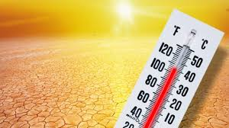
Heat Index =
Temperature & Humidity
When the index reaches 105 degrees, it is time to make adjustments to your normal routine
Decrease time spent in direct sun; cover up; use cooling bandana; reconfigure work to avoid hottest time of day
WIND can help – air movement helps cool
Fans may help if available
The body cools itself by perspiration, which removes HEAT as it evaporates
Important to stay well HYDRATED for this process to work efficiently

Slide 3
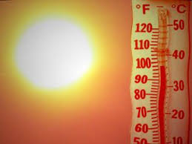
EXTREME Heat Relief Mechanisms
Wear light colors to reflect sunlight. Cover exposed skin. Risk is melanoma; etc.
Open front shirts allow better cooling & ventilation;
Avoid polyester garments – they trap heat and do not breathe as well
Light weight cotton, linen or blend is usually best
Wear loose clothing, upper body and trousers, will allow better air circulation; avoid constricting circulation
Keep sun off back of NECK – this heats blood flowing to brain, gives you headache. Use bandana or kerchief or high vis nape protector
Keep cuffs taped in long grass. TICKS will get on you. Use repellant
Sensitive skin — use SPF, zinc chromate

Slide 4
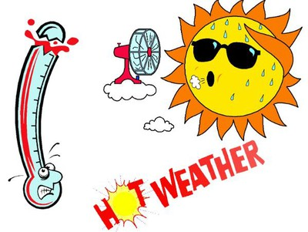
The Game is Changing…
Long term, we will need to find smarter ways to work in high heat
Tents, canopies, shelters, sun shades, umbrellas
Misting fans, air movers
Vehicles parked in direct sun – use windshield screen on EXTERIOR
Watch what you TOUCH. Far example, a piece of sheet metal, such as a door, can burn you on contact. Pay attention!
Heat ‘waves’ are lasting longer and are hotter — not to mention the forest and urban fire potential

Slide 5
‘HOT’ Defensive DRIVING
Your vehicle is under stress in high temps. Check coolant level.
Battery & electrical system is weakened by high heat
TIRE PRESSURES will fluctuate given temperature changes
GATORS from overloaded semi’s will be more prevalent
The speed rating of truck tires is affected by high road surface temps.
No one told the truckers about this…Avoid large trucks as much as possible
Be alert for the indicators that something is about to BLOW UP on the road in front of you!

Slide 6
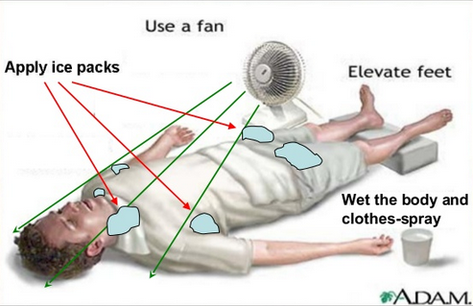
Ergonomic Effects of High HEAT
Severe prolonged dehydration — risk of kidney stone formation
Hydrate with water; NOT ice cold — cool is best.
Sip gradually, steadily; avoid sugar, soda, Red Bull, etc.
Eat LIGHT – Hotter = LIGHTER ; salads, watermelon, veggies
Avoid foods that are fried, preserved, or have a high salt content
Get proper rest. High heat induces early onset of fatigue

Slide 7
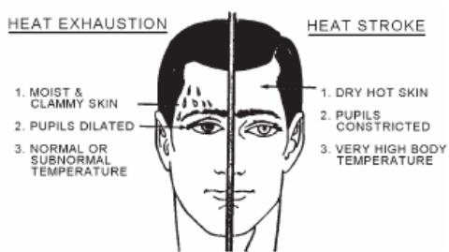
Heat Illness Progression – Warning SIgns
Heat tolerance levels will vary by individual and state of health. Most can take moderate heat without adverse effects.
Be alert for:
Heat Rash
Heat CRAMPS – usually in legs, buttocks, large muscle mass
Heat fatigue, exhaustion. Sit in shade, elevate FEET; hydrate, chill
Heat STROKE: if you ignored all the other signs, this is it.
Call 911
Keep an eye on your co-workers.

