Slide 1

June Safety Info
Safety Tips as We Start the Summer Season
‘HOT WORK’ – Summer is Now
High Temps + Humidity = Fatigue
Workers: Maintain your Free Space!
Work Defensive Driving in Opioid Conditions: Prevention Tactics
‘HOT WORK’ – Summer is Now
Risk Factor Analysis: Hand - Finger – Arm Soft Tissue Injury Prevention
When Did ‘Safety Regulation’ become a bad word?

Slide 2
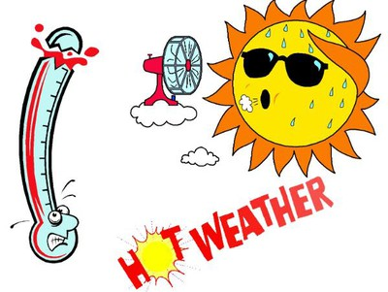
‘HOT WORK’ – Summer is Now
HYDRATE: gulping a couple of bottles of water is not how to hydrate
Be alert for ‘muscle cramps’ = early warning sign of dehydration
Heat INDEX is combination of temp. and humidity; index over 105 is DANGER
Everyone tolerates heat differently. Don’t push your endurance; take rest breaks; monitor contractors; eat light during heat; get sufficient rest; heat induces fatigue
A Work Zone with an extended backup plus high heat will create Road Rage.
Be alert for this; stay in protected areas when possible; vehicle intrusions are common.
Avoid long exposure in direct sun. Figure out a cover up – even a temporary umbrella can help.
PLAN the work in high heat to minimize exposure; take frequent breaks; use cooling bandanas; misting stations, fans, other means of reducing heat load.
Example: avoid prolonged standing on hot pavement. Use cardboard or other insulator.

Slide 3
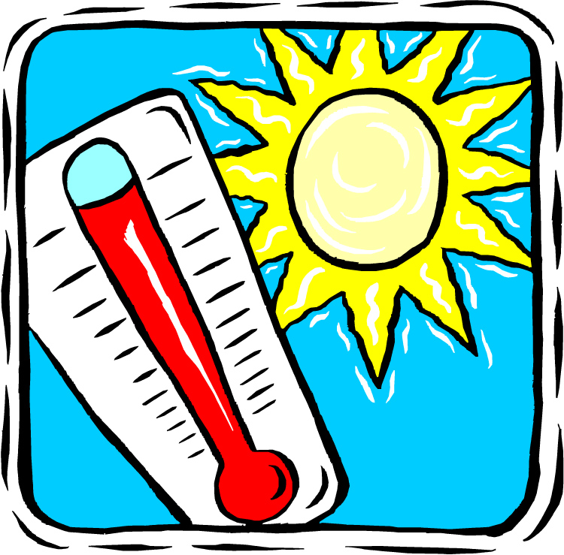
High Temps + Humidity = Fatigue
Rain – watch your hydroplaning
Drainage on slopes, grades, standing water
Slow it down to suit road, weather
Headlights, reflective gear
Distracted drivers, school will be letting out, moving vans, overloaded vehicles, mattresses, furniture, etc.
Always be on the lookout for fatigued, long distance drivers, distractions…

Slide 4
workers: Maintain your Free Space!
An incident was reported where a worker was struck by shovel of hot asphalt: Remember to leave a clear space around people working.
This is magnified when they are using power tools such as chain saws, chop saws, grinders, etc. Even a hammer can cause shrapnel – and mind that back swing!
Same goes when around any vehicles, on the jobsite or elsewhere. People right next to vehicles are hard to see and non-commercial vehicles don’t have backup alerts.
Don’t walk in between vehicles when one is in the process of getting ready to move. Driver may put the vehicle in reverse when you’re expecting forward, and vice versa.

Slide 5

Work Defensive Driving in Opioid Conditions: Prevention Tactics
Statistic: More stoned drivers now on the road than DRUNK drivers
All hours of the day, in addition to bars closing time
YOU = Alertness; defensive positioning; OBSERVE other drivers for signs of erratic driving; always remember and employ the “4 Second Rule”
AVOID Road Rage – high temps can create high emotions
AVOID following too close. This is basically ASKING for trouble from negligent driver
When stopping on Interstate: use full measure of WARNING LIGHTS; deploy upstream SIGNAGE when possible; select best DEFENSIVE parking position; use fully-deployed max. high visibility gear. “Make Sure THEY SEE YOU!!”
Most insurance companies will do forensic analysis following any incident; our company post incident drug test. Protect yourself!

Slide 6
Risk Factor Analysis: Hand - Finger – Arm Soft Tissue Injury Prevention
Even simple tasks can create a hazard if not done correctly; for example…
HANDLING AND DUMPING TRASH. This is classified as Manual Materials Handling.
Fact: improper materials handling is high on the list of hand, finger, back injury causation.
Risk factors include:
1) This is usually viewed as a ‘nuisance’ task;
2) We tend to do it in a hurry; this leads to error, mistake, possible injury
3) Dumpster lids, trash cans, receptacles, are not ‘user friendly’; pinch points; poor grip surface or no handle;
4) Weight of materials can vary a lot; always do a test lift first; use proper lifting posture
5) Handling is usually unassisted;
6) Lighting around dumpsters is often marginal; night shift
7) Spaces around dumpsters may be cramped;
8) May not be using carts or dollies; obstructions include fences, gates, doors, latches, rollers, other hardware, etc.
9) Height of lifting varies, usually above the shoulder (ergonomic danger zone);
10) ‘Snag Hazard’ on bags or materials being tossed into dumpster; use of hand protection (grip gloves);
11) Industrial Hygiene factors; sanitize; abrasions; puncture; impalement hazard

Slide 7

When Did ‘Safety Regulation’ become a bad word?
It might sound nice to ‘dump those pesky SAFETY rules’. Let’s think this through.
Contractor compliance with existing safety rules is estimated as roughly 60% AT BEST
The probability of getting ‘caught’ by the safety police is relatively low; less than .5% businesses are inspected; so why bother? Unless something bad happens…..
An average of 13 persons PER DAY die in US work accidents. 99.99 % of which are preventable. And about 40% are transportation-related. Do the math.
Safety regulations protect people, when they are followed. Which is not all the time.
We need strong enforcement agencies to send the message to the deniers.
Basic truth: you might beat the regulatory system, for example, tax cheats are common. If you get caught, you pay a fine.
However, if the LAWYERS catch you, such as following a really bad accident, you will want to point to your COMPLIANCE WITH EVERY SAFETY RULE UNDER THE SUN as proof of your sainthood. That penalty can be crippling.
Safety Compliance is a double-edged sword.
Think. “What, exactly, do you have to lose?”

