Slide 1

March Safety Info
Spring Fever and March Madness — Not Just Basketball!
Ergonomics 101
Footwear and Back-Related Items
Please Think About These Items

Slide 2

Spring Fever and March Madness Will be occurring even without the sporting events…
The fact is, people often behave unpredictably in early spring.
For your personal safety practice heightened awareness both on and off the job.
Springtime risk factors include: sleep deprivation, chronic fatigue, dehydration, impairments, distractions, etc.
Examples: people running red lights; glare blindness while driving; longer daylight hours equal longer work shifts and less sleep.
A combination of the above factors and more may create unpredictable hazards in any environment.
Practicing personal safety awareness in all situations – on and off the job – is the best defense for March Madness.

Slide 3
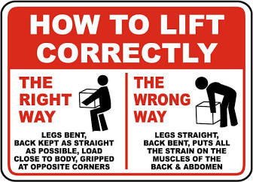
Ergonomics 101
Before you start to lift, be sure you stretch and flex your body. This is medically proven to reduce soft tissue injury, strain, sprains, and etc.
Try to keep the load you are lifting close to you. Avoid a long stretch out in front of your body. Reposition the load or your posture as needed.
Remember: your strength zone is between your knees and chest. Outside of this range, use extra caution.
Use a correct stance and foot positioning, whether walking, standing or climbing.
Avoid prolonged awkward postures; if you will need to be in an awkward position, stretch and flex before hand in order to limber up.
When swinging a tool above your shoulder height, remember that your shoulder is weak when your arm is extended.
When doing a repetitive motion such as hammer strikes be sure to use a benign posture, as well as grip and stance.

Slide 4
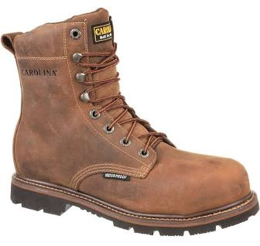
Footwear and Back Health-related Factors
A good pair of work boots will move to more than just protect your feet. Where a pair of boots designed for your work environment. Foot care involves more than footwear but it’s a good start. Condition of boots is important since worn soles and tread means the boot does a lot of the work when it’s in proper condition.
Avoid loose cuffs. Tuck them in or otherwise strapped them securely. Loose cuffs are also a vector for ticks and other insects.
Prolonged standing or walking on pavement or other hard surfaces can affect your feet negatively. Cushion souls or inserts are important to relieve the impact of “heel strike” on pavement. Avoid wearing wet or damp boots. If your job description calls for getting wet feet, keep a spare pair handy for change out. Dry your feet completely after showering, Since this helps foot and toe health. Change socks if needed to keep your feet dry. Allow your boots to dry thoroughly overnight; stuff with newspaper to work out moisture. Remove the insoles and wash or replaced periodically.
Slip and fall prevention starts with a stable platform for the foot. Risk factors include: upper body weight transfer on uneven, irregular surfaces, runs, toeholds, changes in elevation, distractions, carrying objects, walking while yakking on the phone, etc.

Slide 5
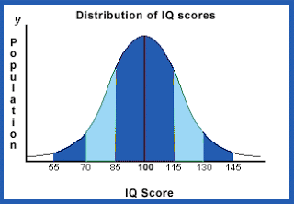
Please Think About These Items
Seasonal ‘shift’ is in process. Risk factors include: fatigue, dehydration; distraction, stress, Covid and flu, general activity level increase, etc.
Annual bell curve increase in ‘incidents’ of all types- spring & summer.
Be alert for ‘Close Call’ situations and report them.
One of our primary goals is to stay ‘incident free’ throughout this year. That would be a great achievement so please stay ‘on message’!!
‘Think Safety’ is way more than just a casual remark.
Covid engendered a lot of ‘Be Safe Out There’ reminders. The outcome is to essentially ‘practice what we preach’, on & off the job!

