Slide 1

May Safety Info
Safety Tips for the Start of the Summer Season
Memorial Day – Summer Kick Off = Start of Accident Season
Hot Nuclear Summer May be on the Way!
High Heat & Hydration Reminders
Work Zone Accident Prevention Tactics
Hurricane Season Starts June 1st; Be Ready
Seasonal Safety From Insect, Reptile, Avian, Critters, Poison Ivy
Slip-and-Fall Avoidance

Slide 2
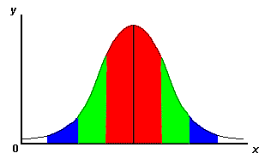
Memorial Day Weekend
Official start to SUMMER – Bell curve of accidents is at high setting in summer months.
THINK – ACT – PLAN – RETHINK – FOCUS – EXECUTE – REVIEW – IMPROVE
This is the mantra of Continuous Improvement – we all need to take a lesson from it.
Driving – Working – Recreational & Leisure – Trip to the Mall – Back yard chores, etc.
Traffic Safety is high on the food chain, but most accidents occur someplace lower on the chart.
Practice prevention through deliberate thought, planning and avoidance of distractions.
ENJOY THE SUMMER — Don’t spend it recovering from an avoidable accident…

Slide 3
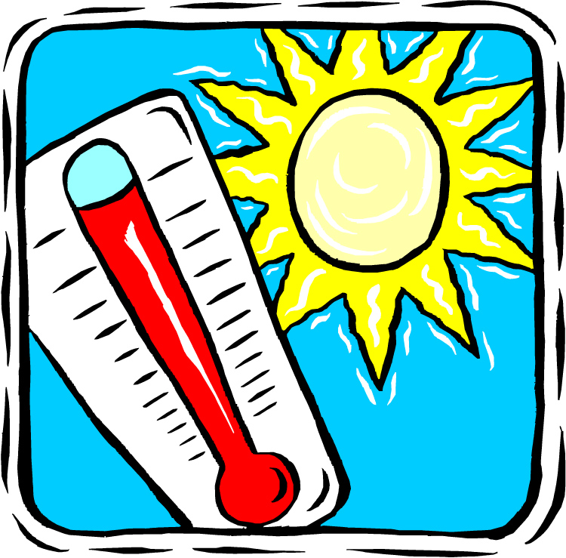
HOT = Nuclear Summer
After Mild Winter – we pay now
Everyone tolerates HEAT differently
Know your limits; don’t push it; acclimate
When possible, plan work to avoid HOT afternoon or direct sun
Gear up with sun resistant, light weight, open front shirt for cooling
Cotton or engineered fabrics and blends are preferred over polyester
Protect HEAD & NECK from direct sun; use cooling bandana

Slide 4
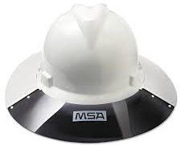
High Heat and Hydration
• It takes more than a couple bottles of water to re-hydrate
• Diet should shift in summer – lighter, more fruits and veggies, less grease
• Melons, tomato, berries, etc. Salads vs. Happy Meal; “skip the fries”
• Less carbonated soda & sugary Red Bull; use water with GatorAde, etc.
• When possible, stay in shade; use sunscreen on exposed skin; cover up
• Wide brim hard hats are available; long sleeves recommended;
• Be alert for early onset effects of dehydration – cramps in legs; fatigue; headache
• First Aid = lie down in shade, raise feet above heart; remove boots; sip cool water; open shirt to allow cooling; AC or Fan to improve cooling effect; if alone, notify someone for backup and monitoring

Slide 5

Work Zone Prevention Tactics
Many accidents and close calls occur at night in work zones.
ALWAYS stay in a defensive position in a work zone.
Anticipate that vehicles may ricochet in unpredictable directions.
Use DISTANCE and LOCATION to protect yourself.
Avoid staying in exposed areas any longer than minimum needed for task.

Slide 6

Hurricane Season
June 1 thru November 30
Storms becoming more severe; wind; rain; destructive power – flash floods in steep terrain
OSHA requires businesses to have an Emergency Action Plan on the books
Stay away from windows; building interior is usually more protected
In a violent storm, a vehicle interior is actually pretty good ‘shelter in place’ option.
Stay away from trees - areas with potential for flying debris - i.e., construction sites
FEMA has raised their max. wind resistance ratings to over 250 mph if that’s an indicator
Forecasting has improved - we will usually have advance notice on violent weather events

Slide 7
Seasonal Safety
Insect, reptile, bird, critter, etc. – Avoid droppings, nests, lairs, burrows, etc.
Poison Plant – learn how to identify – leaves of THREE
Hand and skin protection – use barrier crème to protect
TICKS are especially troublesome this time of year; carrying all kinds of weird illnesses
If they might be an issue,TAPE your cuffs; apply repellant to shoes, lower legs trousers – this is where ticks attach and crawl up
Tall grass, heavy vegetation - extra caution. CHECK your body – ticks find concealed areas to hide.

Slide 8
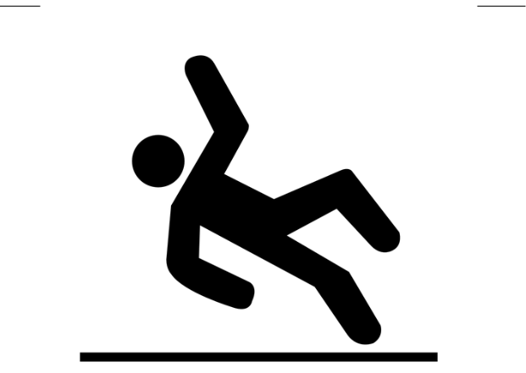
Slip & Fall Avoidance
• Slip & fall incidents are the #1 category of ALL accident reports.
• 60% of our body weight above the waist – in other words we are naturally to- heavy.
• This creates a challenge when walking on uneven surfaces, which is where some are a lot.
• Even a small change in the surface quality or height makes big difference.
      • Which is why WORK BOOTS are recommended; if it might be needed, CARRY A LONG HANDLED TOOL OR WALKING STICK
• Recommended practice is to WEAR GLOVES on work sites – this protects the HAND AND WRIST in a fall
• Be sure to LOOK where you are walking
• AVOID obstacles; step OVER obstacles or go around; LOOK all around you for any hazard- low branches; protrusions; irregular surfaces, etc.

