Slide 1

November Safety Info
• Thanksgiving: Stay safe in the biggest traffic of the year!
• Cold weather is here: Dress and prepare accordingly
• More cold weather reminders and tips
• Report accidents and close calls
• Doing non-standard operations? Review safety/operations prior to using tools

Slide 2

Thanksgiving Holiday Traffic Heaviest of the Year
Thanksgiving is the heaviest volume of all transportation.
We should be planning for the long holiday, probably call-out for incidents.
Big contributors to accidents: fatigue, distractions, marathon trips, unfamiliar routes, substance abuse, speeding - trying to ‘make time’, darkness hours, overloaded vehicles, road conditions, work zones, etc.
Not all drivers are ‘responsible’. Pressures build that can overcome sense of proper driving habits.
Safety Factors include: Seat Belts, Day-Time Running Lights, Defensive Positioning, time of day, volume, etc.
Remember: SATURDAY is statistically the worst day for crashes.
NIGHT driving increases risks; impaired drivers more common at NIGHT
bicycle, occupational – transportation driving
Highway Road Rage incidents are increasingly violent. Use extreme caution with other drivers acting irresponsibly. Back off, give space. Do not engage in confrontational behavior.
THINK before acting. Maintain a sense of personal security. Holidays can cause stress and cause people to do inexplicable actions.

Slide 3

COLD is already creeping in!!
Early Winter?? No problem as long as you’re PREPARED!
Dress in several light layers. Cotton & wool are preferred. Waffle pattern thermals are also effective.
Use ‘long johns’- they’re comfortable and make a big difference in heat retention
Warm air trapped between garment layers is what insulates best
The more severe the conditions, the more we need specialty gear – think: wind, rain, ice, snow, etc.
The longer the outdoor exposure, the more garment engineering we need for protection & comfort.

Slide 4

MORE COLD Weather Tips
Spray outdoor padlocks and hardware with WD 40. This lubricates; removes water that can freeze and break your key.
Use fuel line deicer, especially for vehicles that stay outdoors.
Buy a long reach ice scraper and broom.
Ergonomic handle on a snow shovel can help minimize back pain. Pay the extra few bucks for a good tool.
If you’re not used to shoveling, start slow, take a break often.
Handling tools outdoors in cold- use high grip gloves. You’re aiming for grip vs. insulation. The work activity will ensure enough circulation to keep you warm.
Bonus safety tip: Watch your fingers when opening/closing heavy gates, doors, drawers, tool box lids, etc. Especially outdoors, in WIND! Wear gloves, use a solid grip on handles, keep fingers clear. Then again, the cold will help numb the swelling.

Slide 5

REPORT ACCIDENTS AND CLOSE CALLS!
Close Calls – when they happen… observe, record, report.
PPE – Seasonal gear. Layers are preferred to allow adjustment in temperature swing – use oversize high visibility vest.
Helmet liners are recommended; chin straps should be REQUIRED to keep your hat on when outside your truck in hard hat areas and jobs.
Eye protection can help keep your face warm, protect from blowing dust in eyes and dry air.
Keep loose ends tucked in – draw strings, scarf, etc.
Nuclear Winter – keep a selection of light garments handy

Slide 6
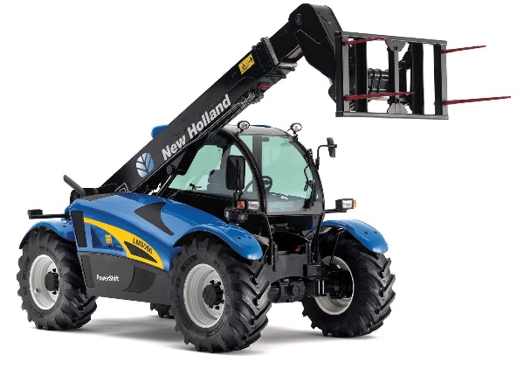
Special Ops – Competency & training
• Small stuff: chain saw, chop saw, angle grinder, skill saw, sawzall, etc.
• Battery operated tools – Especially chain saws can need training
• More complex equipment – Lull; cherry picker; aerial lift; basket – license, training from dealer
• Specific training required: fall protection; confined space
• Common activity: lifting & handling; shovel, sledge hammer; post driver; manhole cover; upper body; legs
• Wear PPE suited to the task
• Look at: weights and distance, forces, volumes, weather, etc. Ask yourself: “What could go wrong?”

