Slide 1


October Safety Info
• Deer season means glare season
• Halloween safety
• Ergonomics of lifting and movement
• Cold Weather Reminders & Tips
• Remember to Drive Defensively!
• It’s Flu Season: Tips to keep from getting it

Slide 2

It’s Deer Season: Moderate Your Speed!
Early morning - Late afternoon - All night
Known population areas, i.e. South West va
Keep a safe protective distance all around you – avoid swerving into other lanes
Two lane road – extreme caution; interstate – stay away from other vehicles
Electronic deer whistles are supposedly more effective than passive, traditional whistles
Pick them up at NAPA and put them on your family car as well as your company truck.
Never swerve! ( Never say never! )

Slide 3

Glare Advisory
Low angle of the sun makes it hard to see animals like deer – or anything else!!
This includes kids crossing the street on way to school and other vehicles.
Pedestrians – minimize your exposure. Cross at crosswalks only. Stay in protected areas
Drivers – Glare can be blinding. Use good quality sunglasses and use your visors.
Be aware that oncoming drivers may not see you because of glare, even with high visibility garments
When outside your vehicle, stay in a protected area; stay well away from moving vehicles or equipment

Slide 4

Halloween safety
Alert your operators to exercise additional caution! Halloween is the 2nd deadliest day of the year for pedestrian accidents (after New Year’s Eve)!
Some malls have Halloween events – you may want to adjust your sweeping time.
Watch for kids at intersections and anywhere near the street or road.
Keep your headlights on, even if it isn’t dark yet.
Eliminate any driving distractions (as you should be already), including phones, food and loud music.
Use extra caution when going through residential neighborhoods.

Slide 5
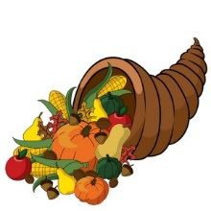
Cooler temps - physiological change starts now
Stay hydrated: The cooler temps will start a month-long process of our blood thickening as a mechanism to help keep us warm.
Important time to watch your diet – avoid junk food and sugary beverages.
Daylight savings time will end soon; adjust your sleep schedule.
Be more cautious when moving anything heavy since muscles will be colder.

Slide 6
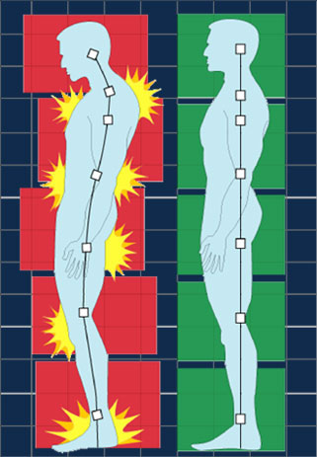
Practice Ergonomics – all season & all activities
Force – Repetition – Posture
Caution when reaching above the shoulder, below the knee.
Avoid ‘out of position’ lifting – adjust posture or get assistance – use a ladder or other assist
If possible, raise loads mechanically – use leverage, hand truck, assistance, etc.
Adjust your seat and controls for optimal reaching and grasping.
Tool use – every tool has safety instructions. Including how to hold and manipulate.
Know and follow the best practices; Avoid hand & finger injuries; use grip gloves
Never raise a chain saw or chop saw above chest height.
Use proper stance getting on or off truck or equipment; keep hands free to grab and climb

Slide 7
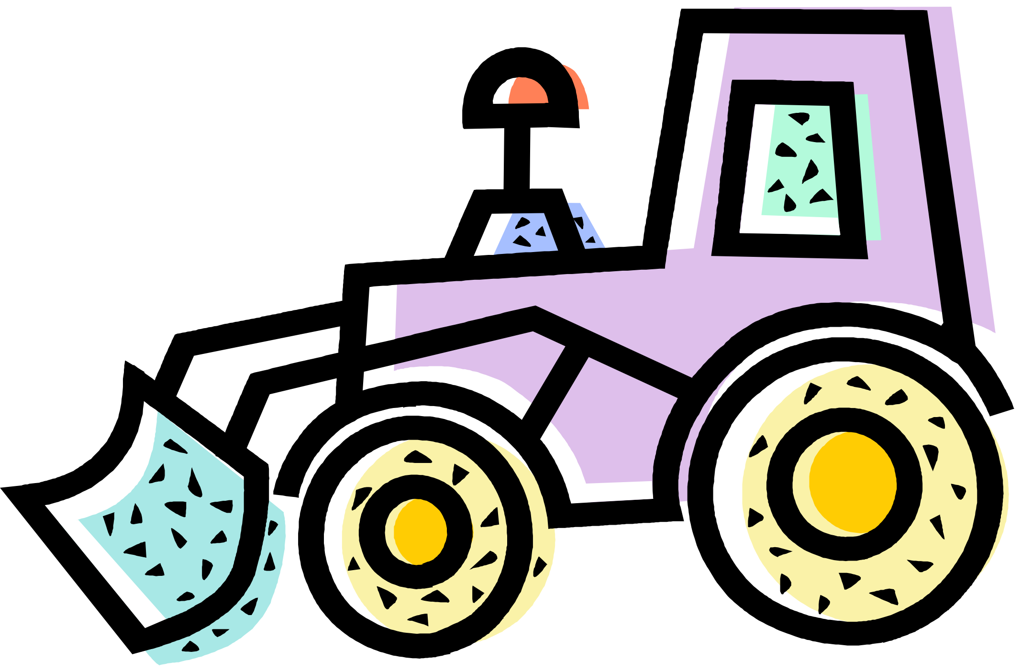
COLD Weather Tips
Spray outdoor padlocks and hardware with WD 40. This lubricates and removes water which will freeze, break the key, and generally slow you down.
Use fuel line de-icer, esp. for vehicles that live outdoors
Buy long reach ice scraper and broom
Ergonomic handle on snow shovel can help minimize back pain. Pay the extra few bucks for a good tool.
If you’re not used to shoveling, start slow, take a break often
Handling tools outdoors in cold — use high grip gloves. You’re aiming for grip vs. insulation. The work activity will ensure enough circulation to keep you.
Bonus safety tip: Watch your fingers when opening/closing heavy gates, doors, drawers, tool box lids, etc. Especially outdoors, in WIND! Wear gloves, use a solid grip on handles, keep fingers clear. Then again, the cold will help numb the swelling.
Stay hydrated: The cooler temps will start a month-long process of our blood thickening as a mechanism to help keep us warm.
Important time to watch your diet – avoid junk food and sugary beverages.
Daylight savings time will end soon; adjust your sleep schedule.
Be more cautious when moving anything heavy since muscles will be colder.

Slide 8
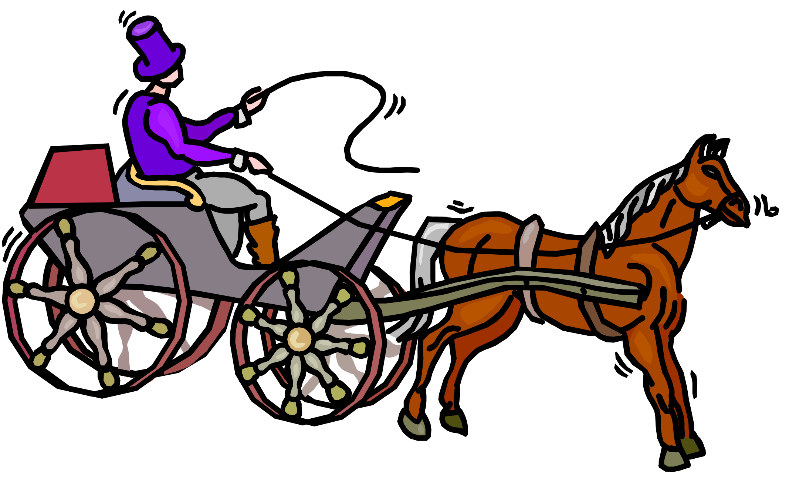
Drive defensively !
LEAVE enough space all around you. Remember the 4-Second Rule. This should be a habit-forming characteristic.
Because when you do it often enough, you will actually be uncomfortable when you do forget and get too close!!
LOOK well ahead of you. Prepare to react to what’s going on up ahead. If you see brake lights, immediately back off, check your rear and sides. Get the Big Picture.
Avoid sudden lane changes. Signal well in advance, check your mirrors and blind spots. LOOK over your shoulder before moving over.
Change lanes SLOWLY! This is to allow the guy you’re cutting off some time to react.

Slide 9

It’s Flu Season: Tips to keep from getting it
1) The Biggest Help Factor: Get a FLU SHOT – usually free at local pharmacy. You got half a chance.
2) Stay Hydrated – important first line of defense for your body.
3) Use hand sanitizer – avoid bare skin contact with icky surfaces.
4) Cover your mouth and nose when cough or sneeze.
Remember: Most airborne flu virus enters body through the EYES. Logic would ask: does wearing wrap around style safety glasses help?? No one is exactly sure, but in theory, it can’t hurt. But if out in public, we’d recommend that you buy the nicest looking wraparound glasses available.

Slide 10

Tips for Changing Season
Keep in mind, as the season changes, so does our Circadian Rhythm and metabolic processes.
For example, our circulatory and kidney systems will begin to adjust for cooler temperatures.
Proper diet and hydration are important factors in this process.
For the ‘average’ person, not a big deal.
Proper rest cycles are also important. Fatigue can affect perceptive ability for example.

